Slide 1
Sediment Solutions Community of Understanding
Highligts autumn 2021 excursion preparation
18th of June 2021

Slide 2
Excursion – first physical meeting
Challenge in its own
Short in time
Long in distance
So much to see and discuss
Difference in backgrounds participants
Challenge due to personal health and Covid-regulations
Still, who can help?
From local (choosen) site approach
Be part of the overall excursion agenda committee

Slide 3
Excursion – planning
Excursion 7th – 9th of October 2021
Traveling to the starting point
Starting Thursday 7th at 12:00 (at the starting point)
Ending Saterday 9th at 12:00
Optional extended programm (till e.g. 18:00)
Traveling home
Is early October 2021 feasible?
Following EU and national Covid regulations stricktly
Feel free to react how you (!) would feel comfortable
Pre-registration before 15th of July 2021
Around 15th of July 2021 go/nogo.
Dealing with Covid-19
Are you willing to travel? Are you allowed to travel?
Dealing with practical issues
EU Covid passport
Access to hotels etc.
PCR testing
Let us know your personal ideas

Slide 4
Excursion – parallel organization alternatives
When 7-9th of October excursion is not feasible …
Postponing the excursion to spring 2022 (with help PRW)
Organizing more low key and more local alternatives
Physical
Online
Via (social) media e.g. VLOG’s
Ideas and offers are welcome
Feel free to use, modify and add to the Factsheets. Feel free to add extra information.

Slide 5
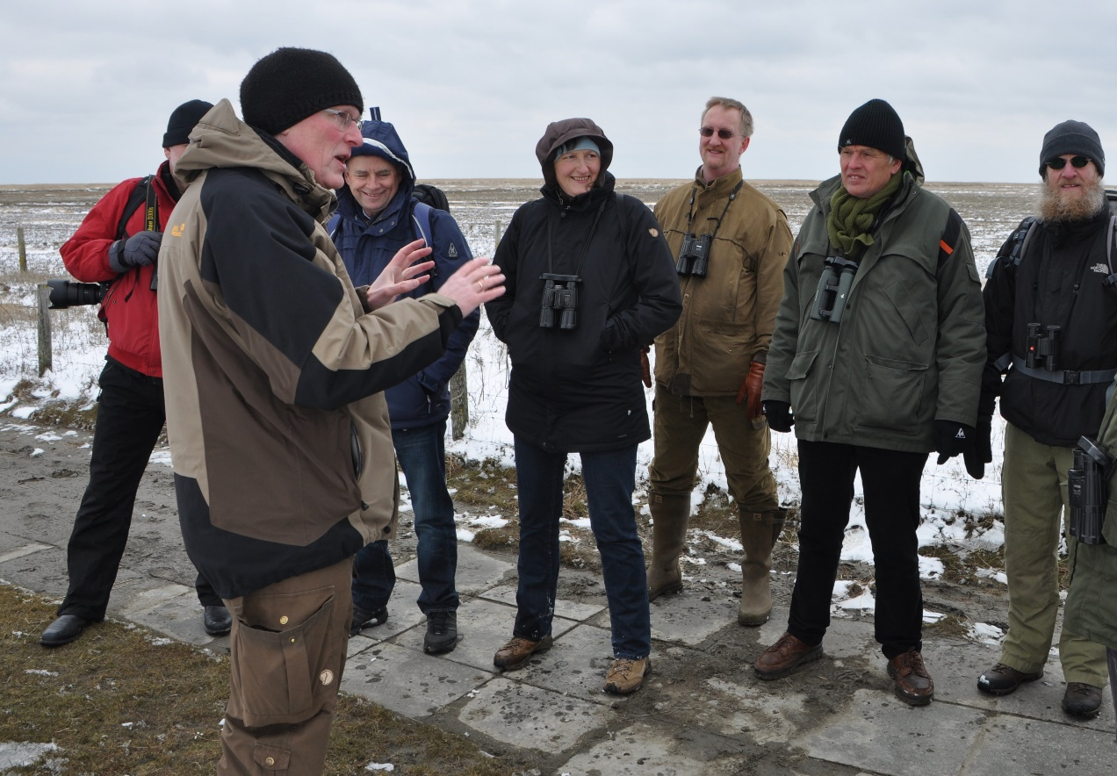
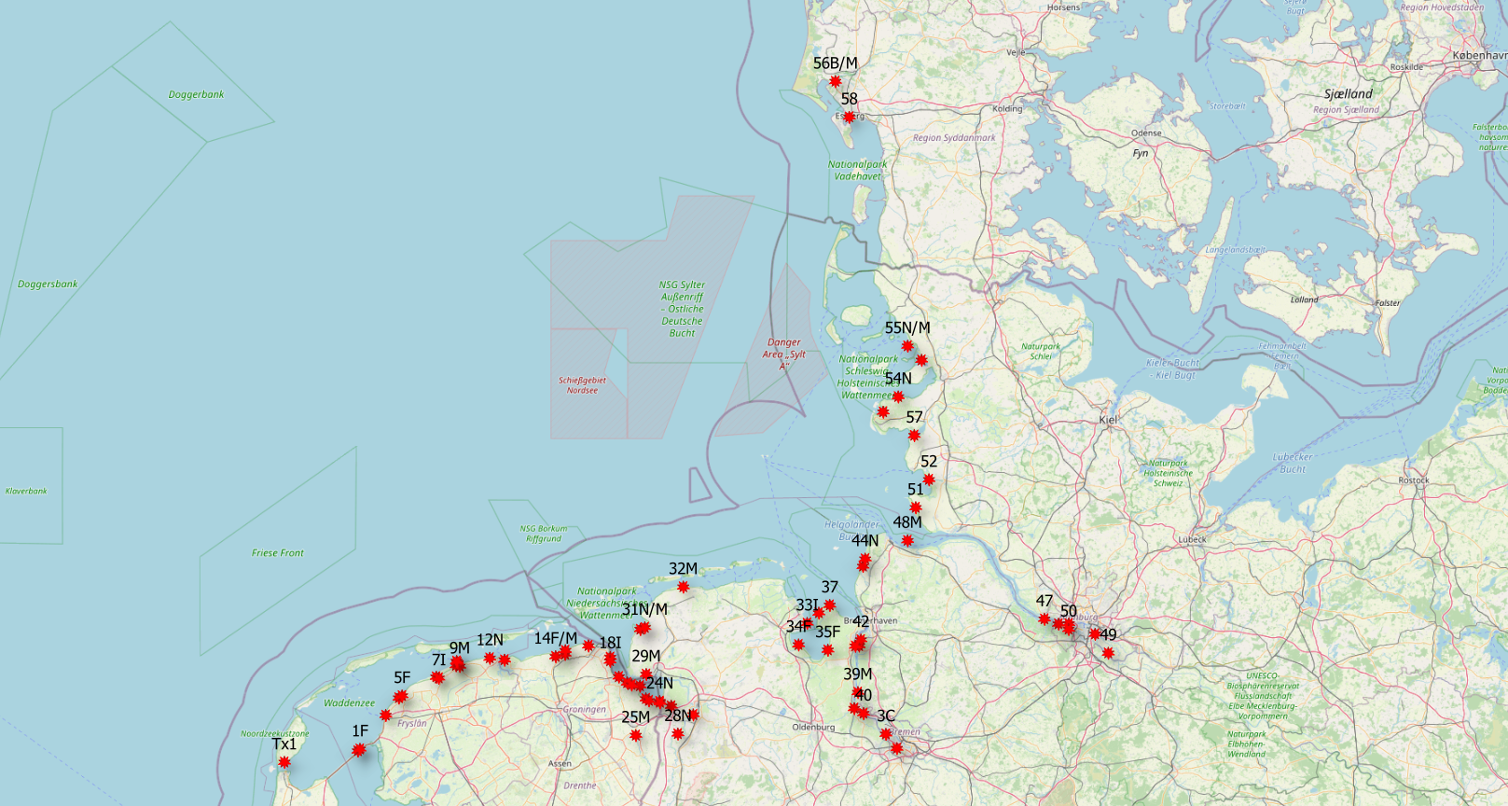
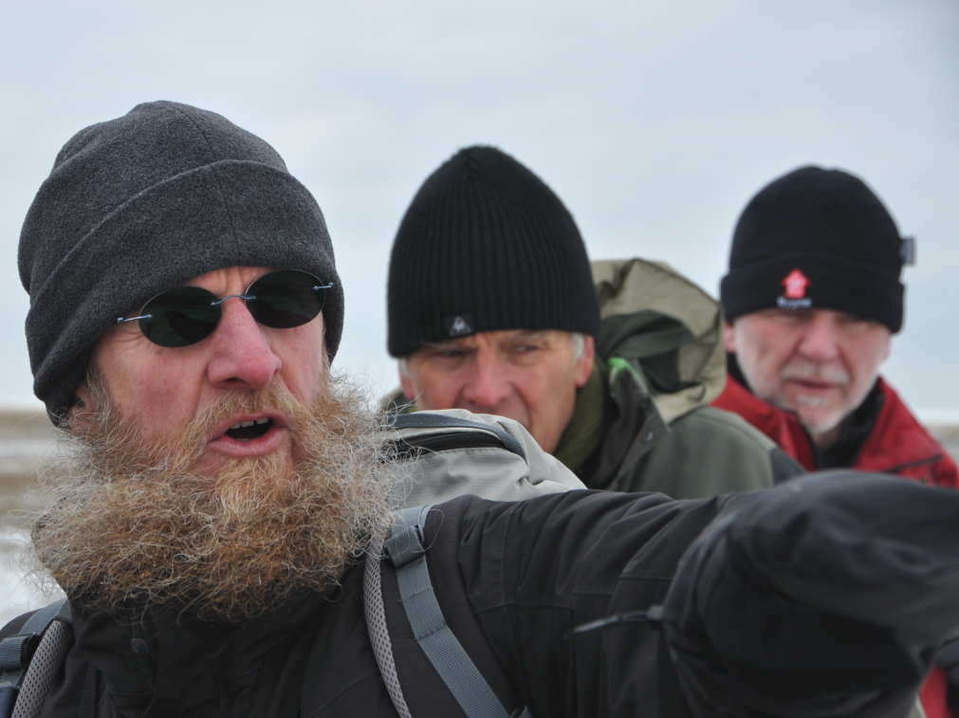
Sites of interest – we have to choose

