Slide 1
Retaining sediment as foundation for ecosystem services of coastal vegetation Oliver Lojek & Maike Paul
Notes:
‚Ökosystemservices' und die Wechselwirkung biotischer und abiotischer Faktoren mit dem Sediment auch hinsichtlich Küstenschutz angesprochen werden. Zu diesem zweiten Themenblock möchten wir von deutscher Seite Vertreter des Projektes ‚Gute Küste Niedersachen‘ einladen, um der Community dieses Großprojekt vorzustellen.
Vortrag 15-17 minuten

Slide 2
Challenges for coastal protection in the area
Ggf als Einleitung, kennen aber alle auch schon
Climate change induced sea level rise has additional consequences
Increase of tidal range up to 30% (for sea level rise < 2m)
Increased flow velocities, especially in inlets between islands
Deeper water leads to higher waves under otherwise same conditions
Turbulence can increase, potentially leading to more erosion
Need for renewed or strengthened coastal protection measures
Arns et al., 2017
Notes:
In the future, sea level rise accompanied with additional consequences…
Need to improvement of coastal protection measures.
Total dike line length of Lower Saxony: 700 km, dike strengthening: 7 km per year, coastal protection costs 40-70 mil Euro per year, time to completion: 100 years, no trial-error approaches
nature-based solutions as complement for technical measures

Slide 3
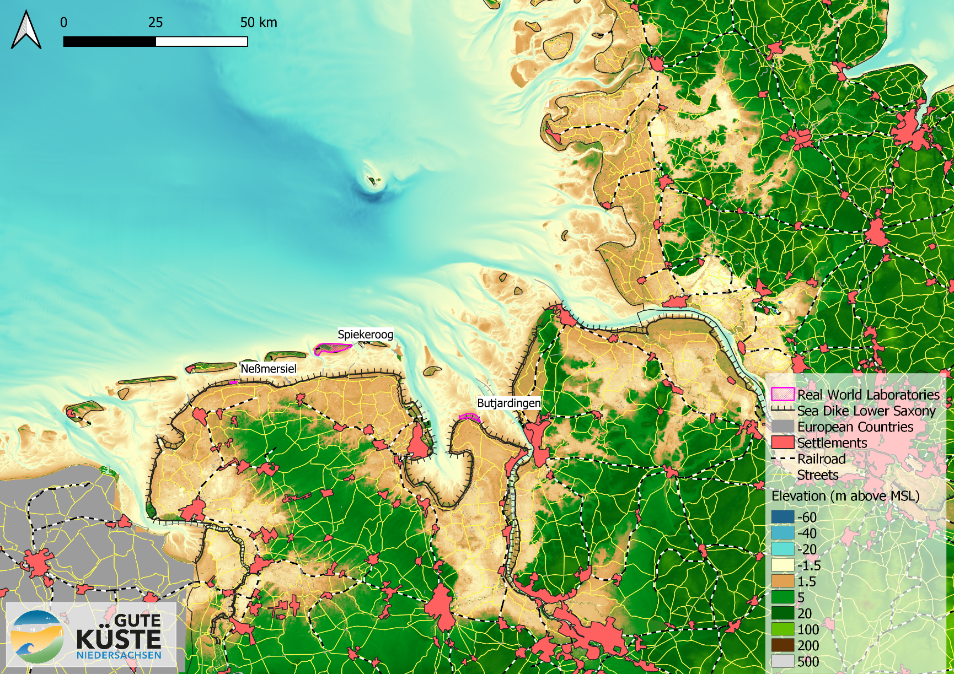
Real World Laboratories
Field sites
Mainland coast
Estuary peninsula
Barrier island
5 years runtime
3 Universities
7 Institutes
>25 scientists

Slide 4
Coastal protection measures and NbS
Coastal protection in this context means protecting housing and infrastructure, the coast and the hinterland from erosion and against marine flooding.
Nature-based coastal protection is considered to
Be sustainable
Contribute to coastal protection requirements
Provide co-benefits for the socio-ecological system through the provision of multiple ecosystem services (ES)
Maribu (2017) World Ocean Review 5
Notes:
What is meant by coastal protection…
We have heard yesterday by Emmanuelle a detailed definition of NbS and if we combine this with costal protection it is considered to…
Traditional coastal protection (LEFT): technical measures to separate land and sea or reduce impact of the sea on land.
nature-based coastal protection to provide the same standard of coastal protection plus other ES. Sustainability in this context: Dynamic response to changing climate possible
May differ slightly from NbS concept presented yesterday, but coastal engineers not familiar with NbS concept and interpret term more freely. Large gap between disciplines here.
IUCN definition of NbS used in the session: Nature-based Solutions (NbS) are actions that protect, restore or sustainably manage ecosystems and the services they provide, to address major societal challenges, simultaneously providing benefits for biodiversity and human well-being.

Slide 5
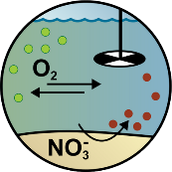
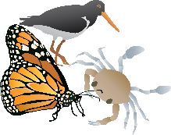
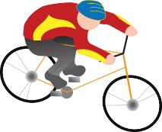
ES of nature-based coastal protection
Mögliche Folie, falls Du das Gesamtkonzept von ES in GKN vorstellen willst
Water quality
Science
Habitat
Renewable energy
Flood control
Erosion regulation
The key ES for coastal protection in combination with the additional ES are leading to co-benefits
Enjoyment
Conservation
Key ES for coastal protection
Heritage
Climate regulation
Recreation
Material extraction
Symbols obtained from Integration and Application Network (ian.umces.edu/media-library)
Notes:
Here ES that result in co-benefits are shown.
For coastal protection erosion regulation and flood control the most important ES
But: many linkages and interdependencies with other ES. e.g. ...
Thus we put the (whole) system into focus and want to find strategies for coastal protection that have co-benefits for other ES as well
Point out Kremena‘s talk.
Note that within the project we use the term co-benefits for the resulting bundles of ES and not in the way it is defined in the ES cascade. Let me show you some examples
General comment - while in GKN "co-benefits" is used as a synonym of "bundles of ES", in the ES community it is not like that. Benefits are the consequesnces of ES (ES cascade) and are things like safety, healt, etc. Here is a nice list: https://bityl.co/6pdT (source: https://bityl.co/6pdW). Some social scientists in the ES comunity focus mostly on that part of the cascade. I personaly have mostly worked more on the left part (how ecosystem structures and processes convert to ES). So I am far from an expert on that. But if questions about that come to Maike, it is better to be prepared. I think that it will be enough just explaining that we are aware of the difference and the role of benefits in the system, but we are not focusing heavily on that. Just on the presumption that bundles of ES contribute to more and more diverse benefits for people and the environment.

Slide 6
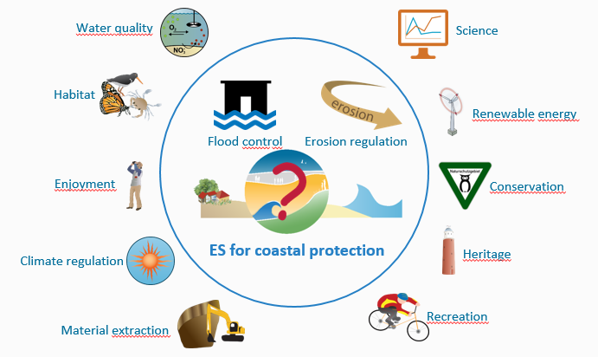
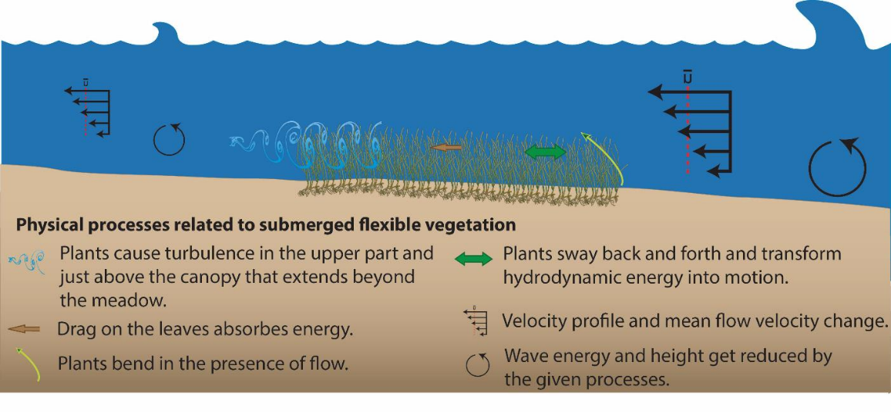
Project approach (represented through the ES cascade)
Mögliche Folie um zu zeigen, wie wir biophysikalische Prozesse in ÖSL übersetzen
Oder um das Gesamtkonzept von ÖSL in GKN vorstellen willst
Management strategy: Nature-based coastal protection
Maribu (2017) World Ocean Review 5
Co-benefits
Human and environmental well-being, safety and health; sustainability
Ecosystem structures and processes Assessment of e.g. vegetation characteristics, flow reduction
Ecosystem Services assessment
Indicator based, biophysical and socio-cultural assessment
IUCN
Adapted from de Groot et al. 2010, Haines-Young & Potschin 2010
Symbols obtained from Integration and Application Network (ian.umces.edu/media-library)
Notes:
To develop such strategies, we apply the ES cascade by CLICK assessing ecosystem structures and processes.
Feed into ES assessment together with socio-cultural assessment of ES of management strategies
CLICK The resulting co-benefits will then help to inform the choice of new management strategies.

Slide 7
Ecosystem structures and processes - biophysical assessment
Symbols obtained from Integration and Application Network (ian.umces.edu/media-library)
Notes:
Biophysical assessment to quantify processes relevant for coastal protection (erosion protection, flood protection). These are the processes nature based coastal protection is based on.
Here example for seagrass. Same processes for other plants in water and/or air.
Addition: Sediment dynamics.
We study above ground biomass, below ground biomass, soil properties, sediment transport, flow and wave patterns,

Slide 8
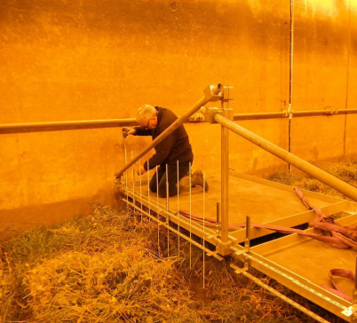
Salt marsh stability under storm conditions
Horizontal bed
Live and healthy salt marsh
2 m water depth
Significant wave heights up to 0.7 m
1000 waves per day
day 1-4
day 10-11
mowed vegetation
Spencer et al., 2015
day 7-8
Notes:
We then mowed the vegetation…
And the question was what happens in winter when the plants are less vital and in under breaking waves in shallow water?

Slide 9
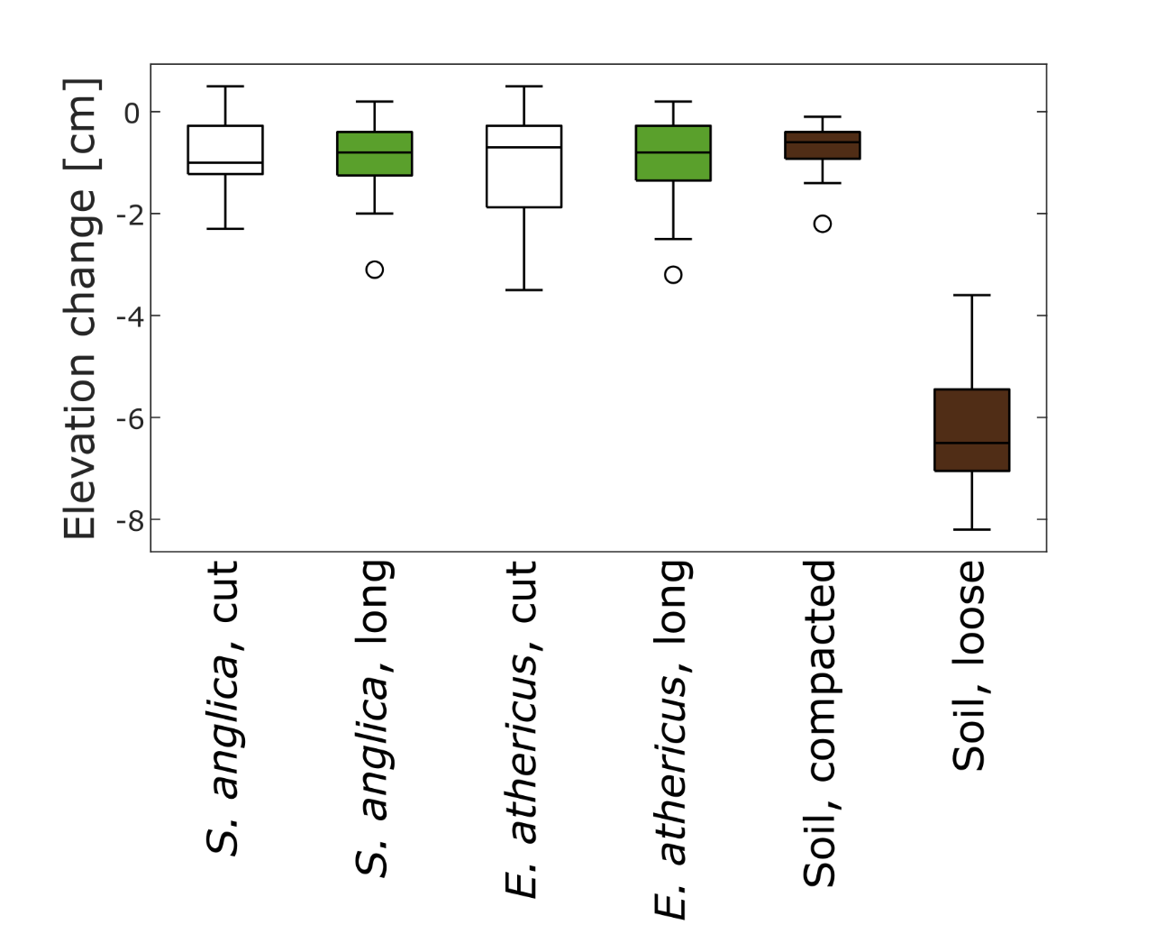
Salt marsh stability under breaking conditions
1:7 slope
Winter state salt marsh
Breaking and run-up zone
3000 waves, H_{s} = 0.2 m
Paul & Kerpen, 2021
Notes:
And here are the results pooled across the whole patches.
Green = above ground biomass present, white = above ground biomass cut off, brown = just soil, no below ground biomass
again not much happened, but a little bit more than under the storm conditions shown on the first slide. And, no difference between species or presence – absence of above ground biomass. Only the loose soil eroded significantly more.
Bulk density for lose soil not representative as sample taken after the test when most of the lose soil was eroded

Slide 10
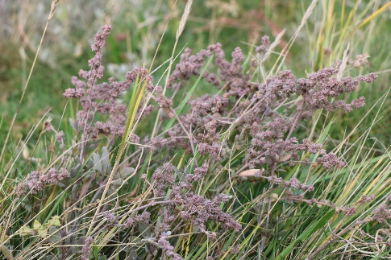
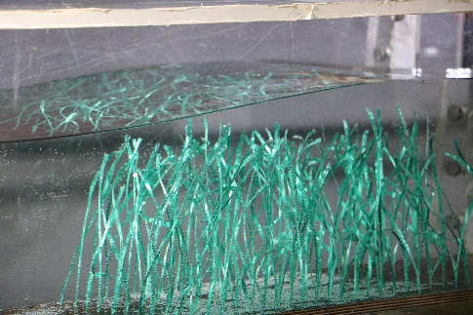
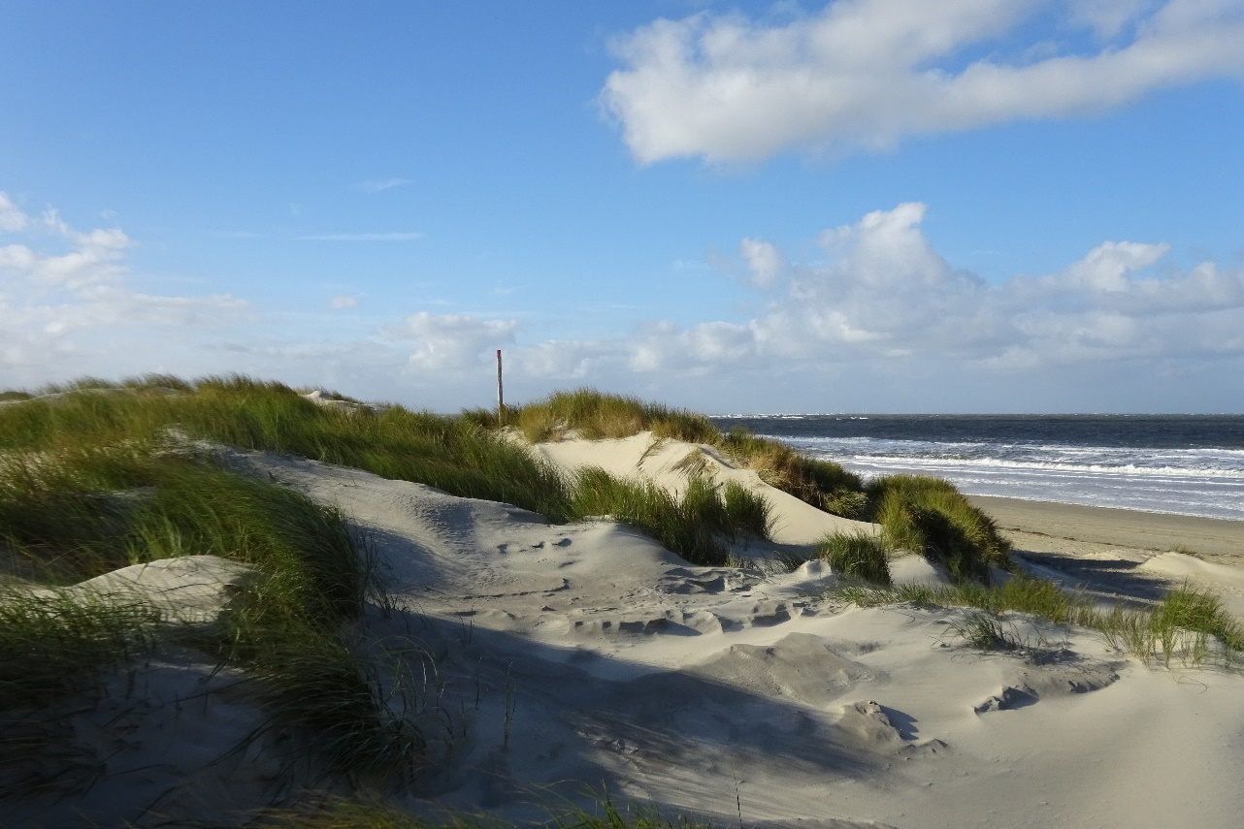
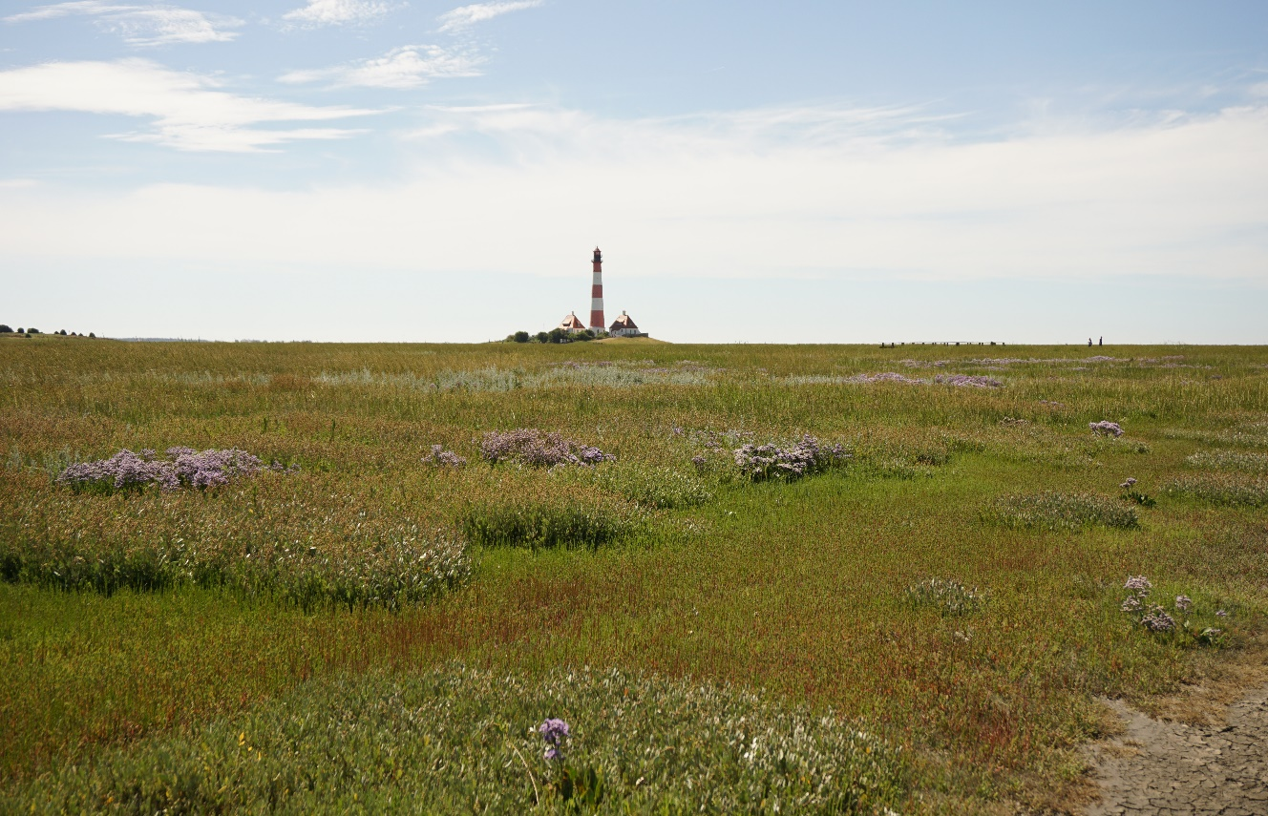
Vegetation characteristics (Salt marsh & dune)
© Keimer
Aim: Develop dynamically and geometrically scaled surrogate vegetation models for systematic laboratory tests to quantify ecosystem services wave dampening & erosion protection
Methods:
Vegetation mapping (predominant species)
Monthly assessment (biomechanics & soil characteristics)
Environmental parameters (aeolic sand transport, waves, hydrology)
In situ sensors for contineous soil monitoring (salinity, temp., humidity)
Regular terrerstrial/aerial laser scans to map topogrpahic changes
Lab analysis of vegetation samples (histology, flexural stiffness)
Complimentary data acquisition of nearfield wave charactertistics and currents through permanent radar station, cameras and episodic ship based campaigns (MBES, ADCP, CTDs, LISST)
Results: Supra- and subterranean seasonal characterization
© Keimer
© Keimer
© Kosmalla

Slide 11
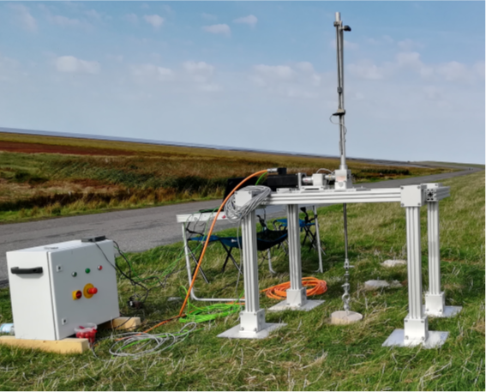
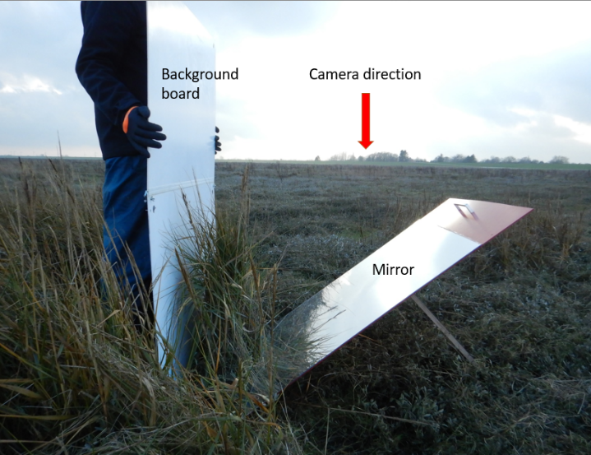
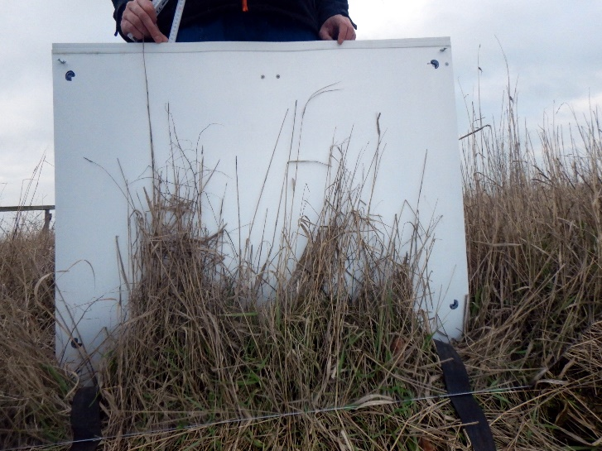
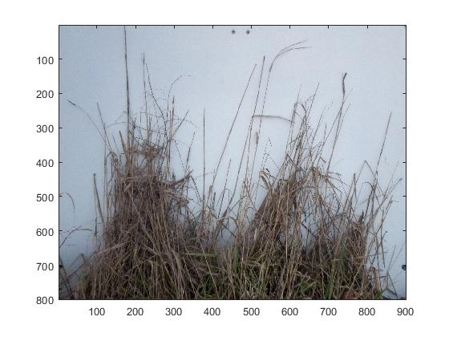
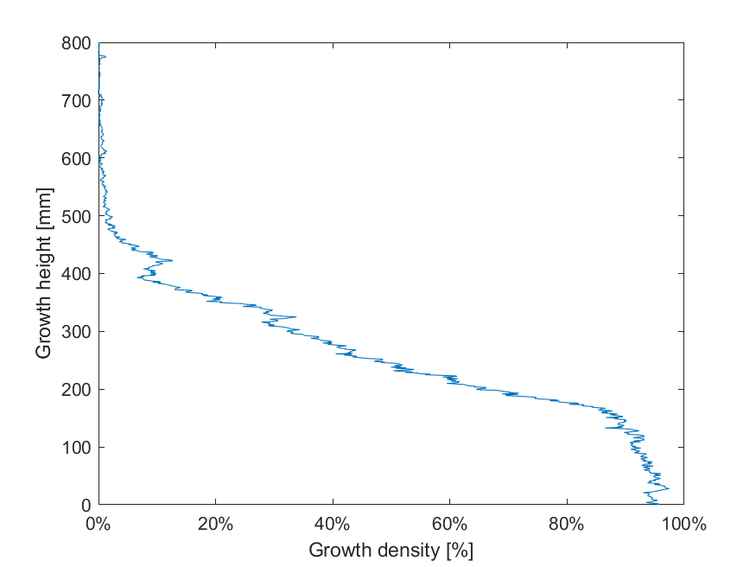
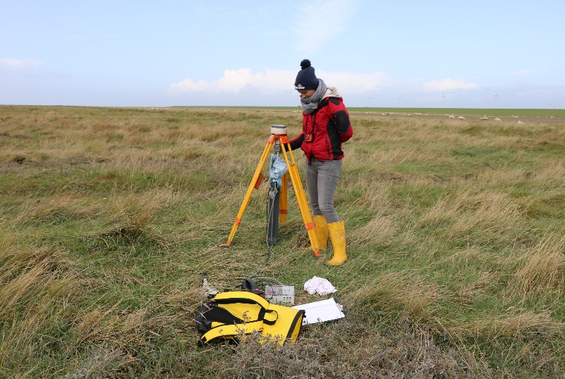
Vegetation assessment (Salt marsh & dune)
Monthly vegetation assessment
1. Height and density
Fotomethod
2. Soil shear resistance
DiCoastar
3. Pull-out-resistance
Complementary:
Soil sensors, wave gauges, wave buoys
Laserscans for topographic data (dGPS referenced)
Sandtraps for aeolic transport characteristics
Vegetation samples
© Kosmalla
© Kosmalla
© Michalzik
© Keimer

Slide 12
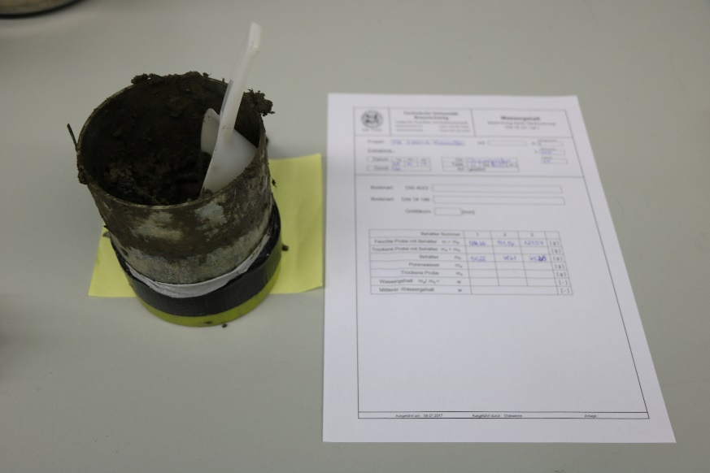
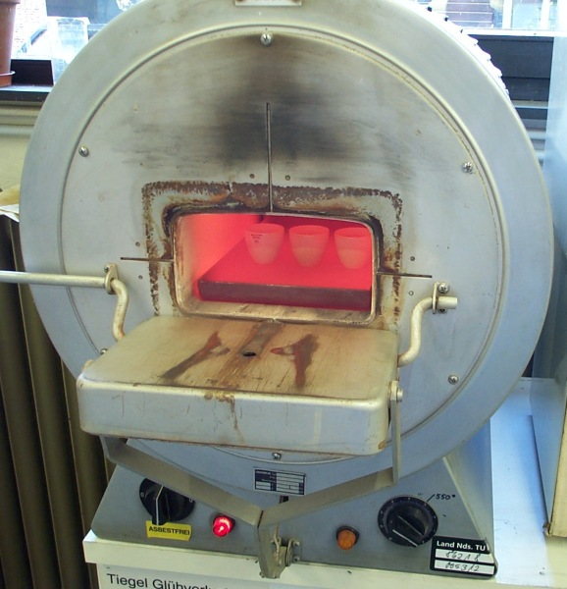
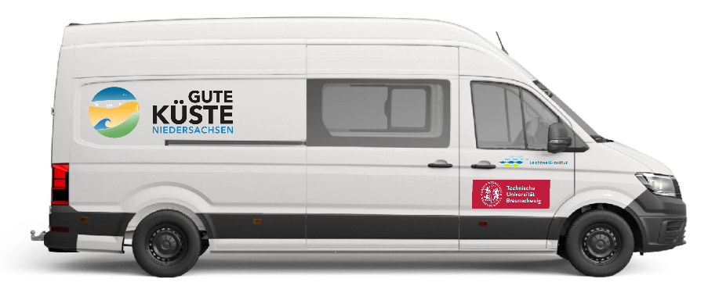
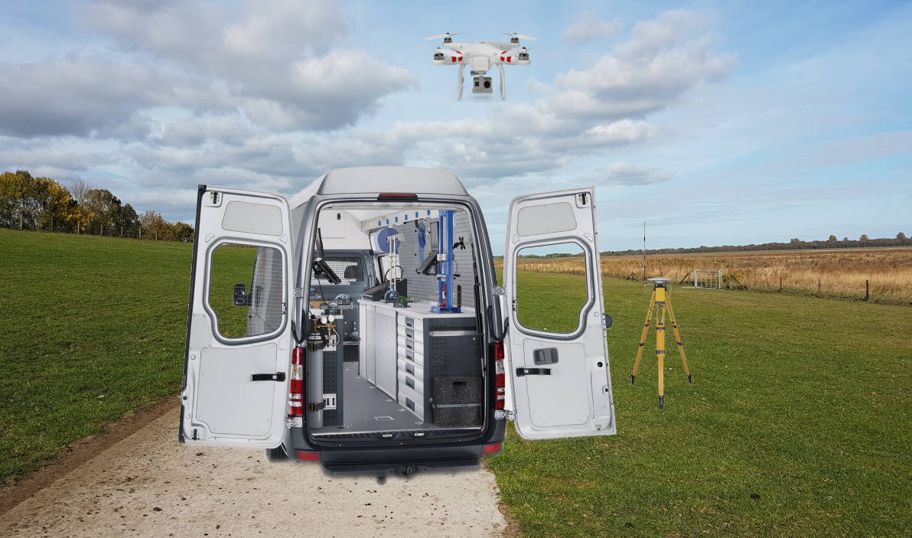
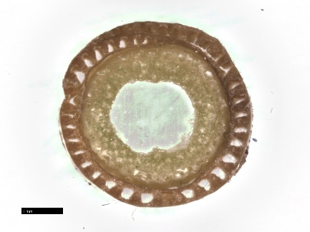
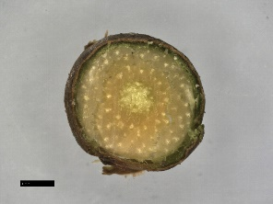
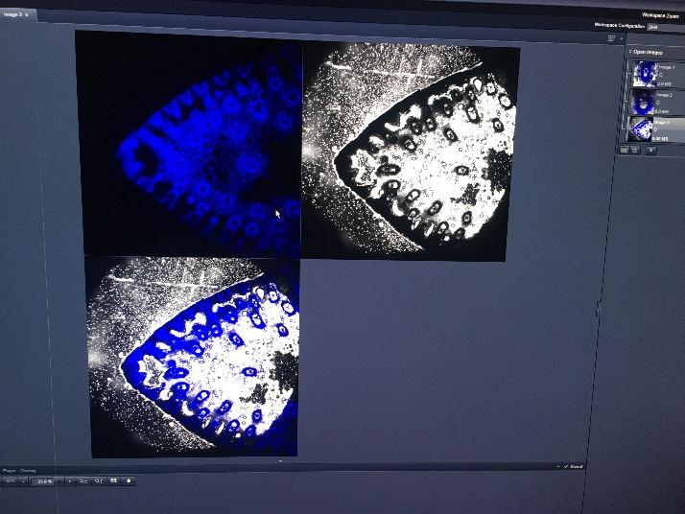
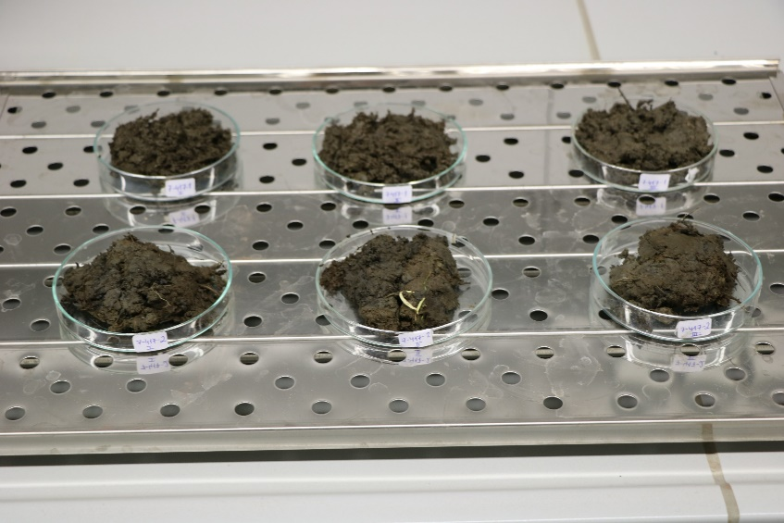
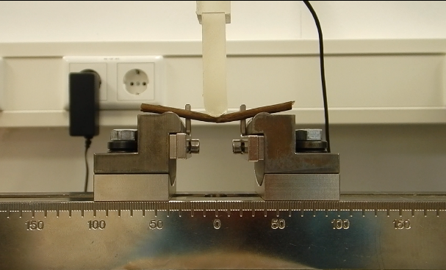
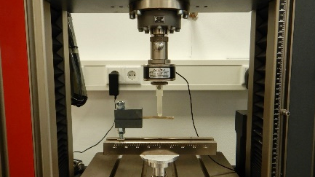
Vegetation assessment (Salt marsh & dune)
Stationary Soil Lab (Island of Spiekeroog)
Organic matter content
Root length density
Sieve curve
Mobile terrestrial lab
Microscopy
Flexural stiffness
Area moment of inertia
© Kosmalla
© IGG (TUBS)
© LWI (TUBS)
1 mm
1 mm
© Kosmalla
Spartina anglica
Elymus spec.
© Kosmalla
© Kosmalla
a) 3-point-bending
b) 2-point-bending

Slide 13
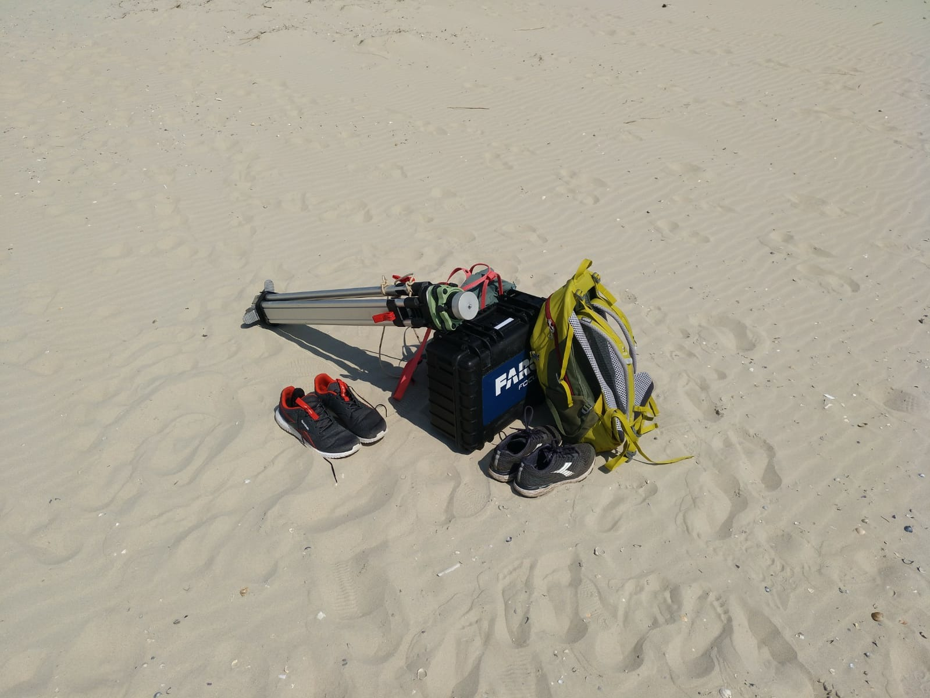
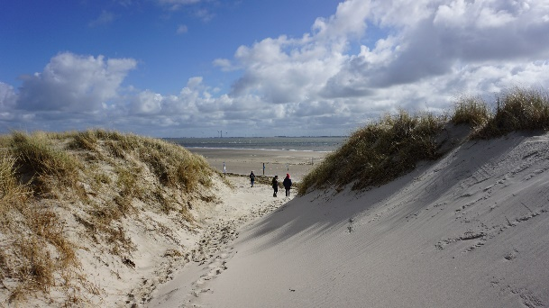
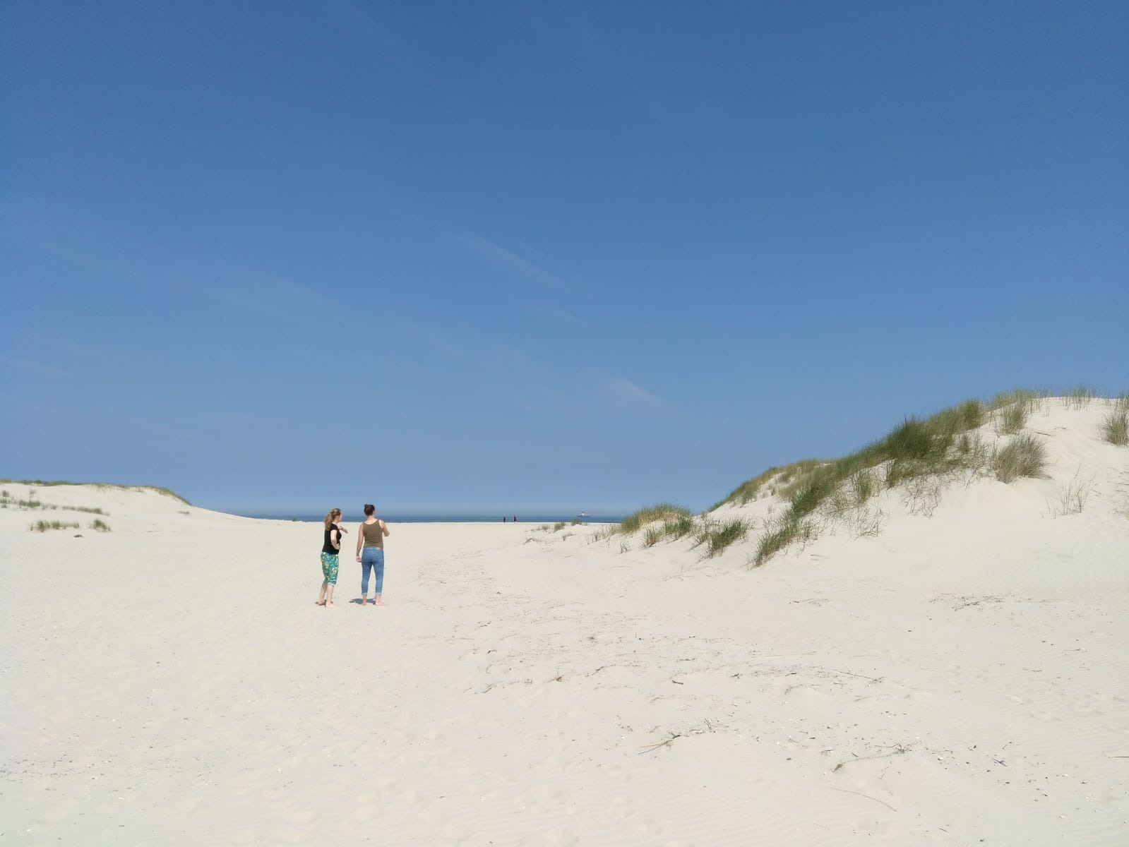
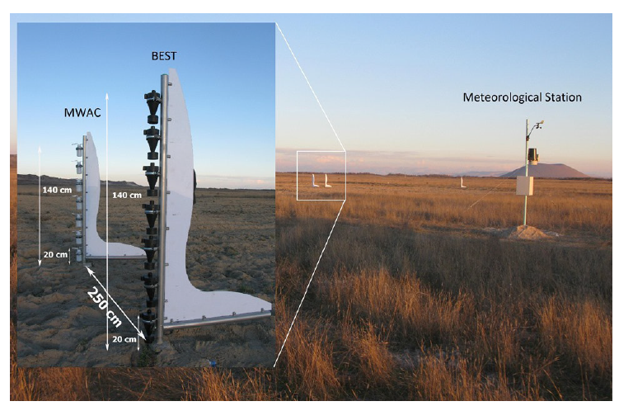
Dune vegetation assessment
Four different dune areas
Biomechanical characteristics
Laserscans
Aeolian measurements
Soil monitoring
→ Current work
Tentative results:
Quantification of dune erosion resistance added by vegetation
10.06.2021, Spiekeroog
10.06.2021, Spiekeroog
10.06.2021, Spiekeroog
© Basaran et al. (2017)

Slide 14
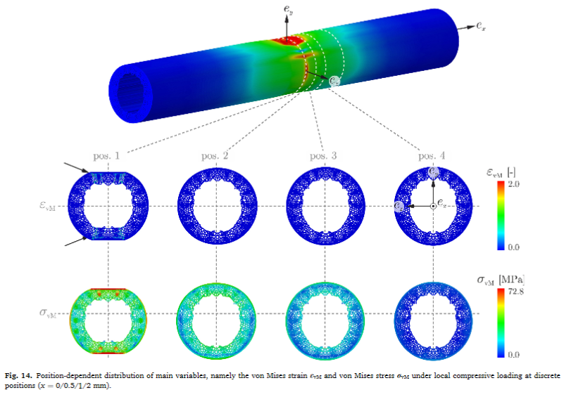
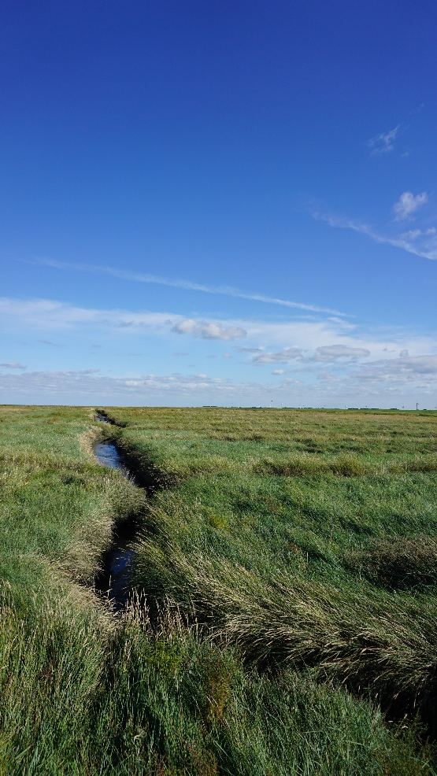
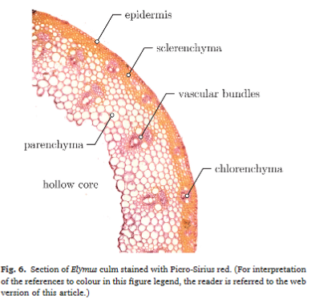
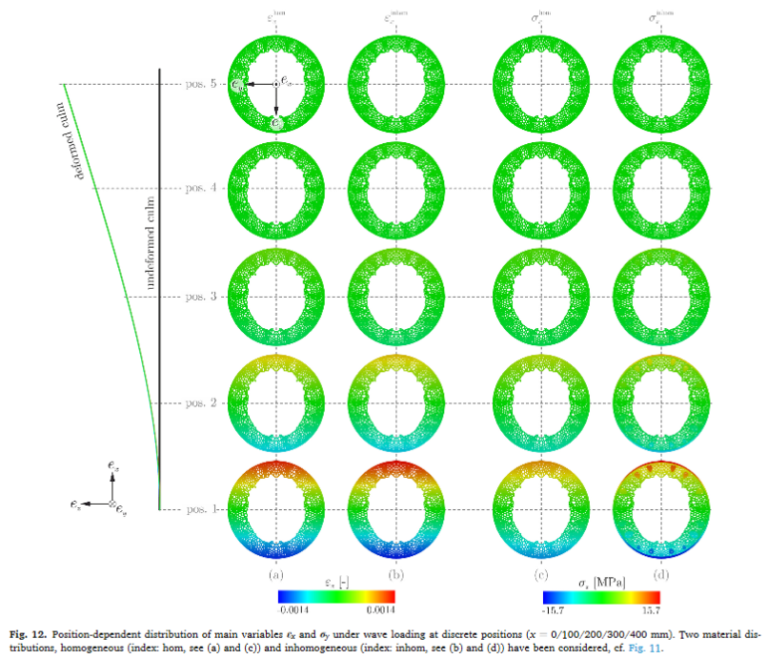
Salt marsh vegetation results
Numerical model
Biomechanical characteristics
3D-Model based on field assessment
Further species needed
Soil not yet included
Project wetland restoration effects
→ Ongoing work
25.09.2020, Neßmersiel
Keimer et al. (2021): Experimental characterisation and three-dimensional modelling of Elymus for the assessment of ecosystem services. https://doi.org/10.1016/j.ecoleng.2021.106233

Slide 15
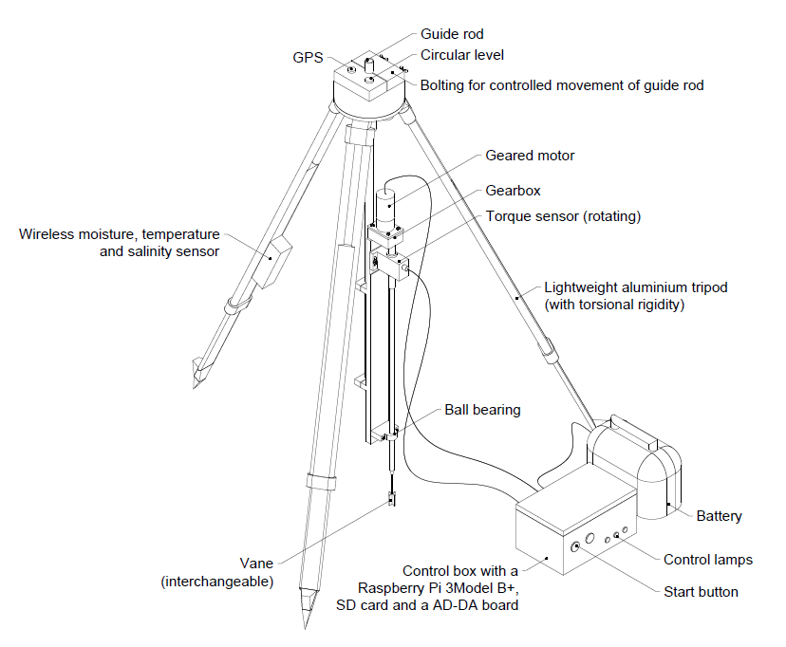
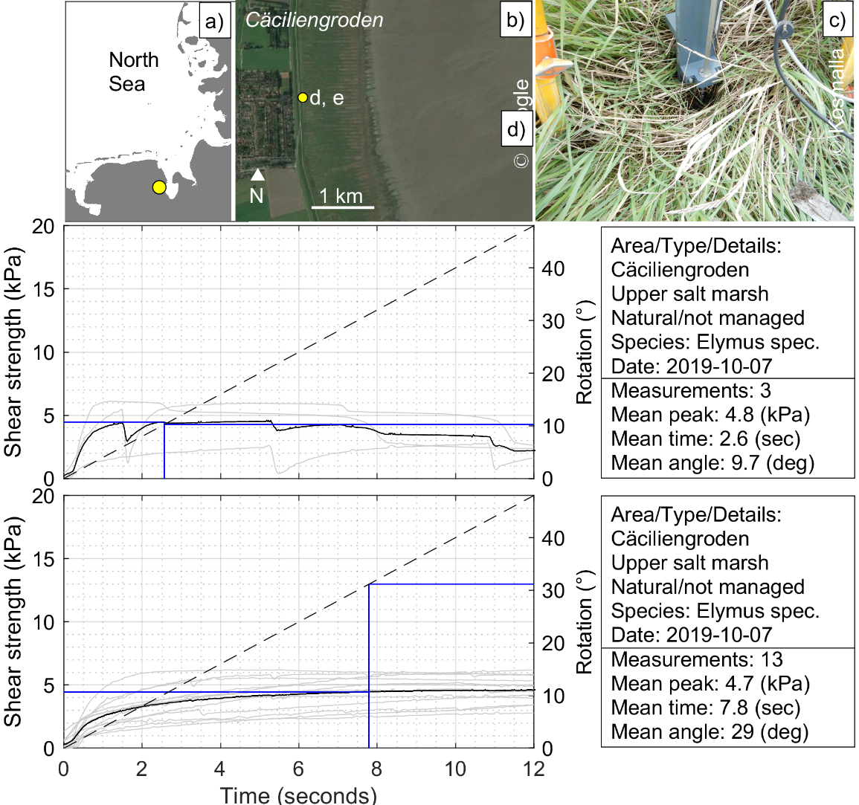
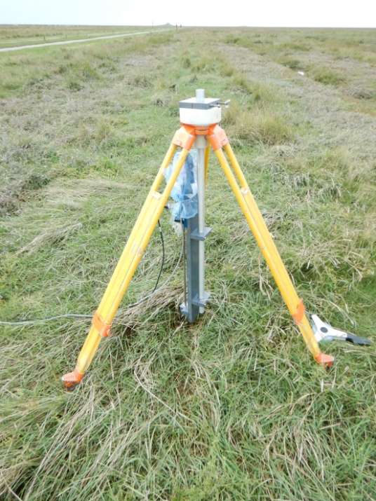
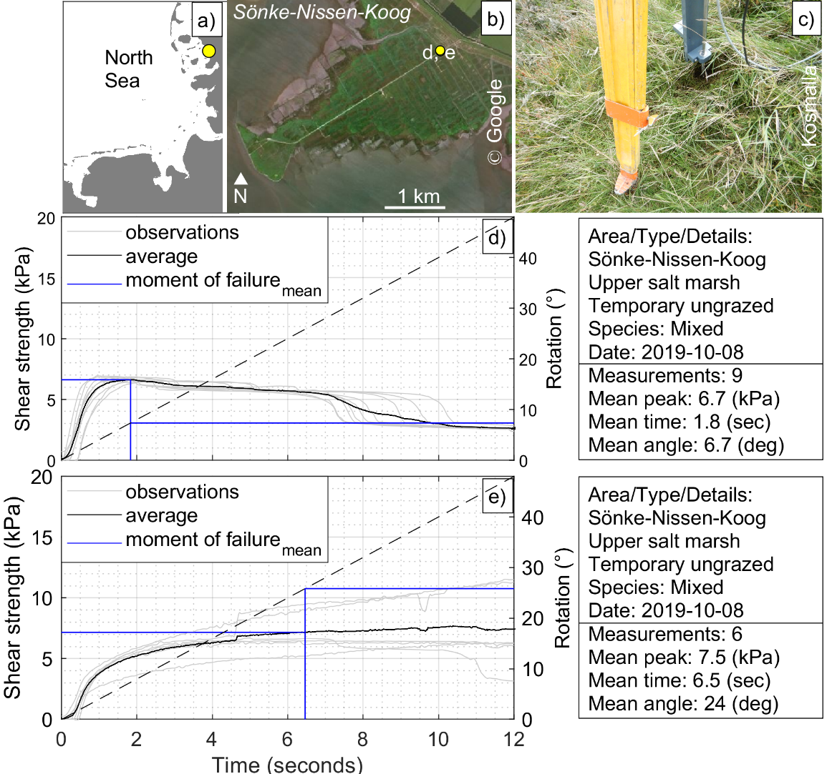
Soil resistance results
DiCoastar© Shear resistance measurements of soil-root-complex
Seasons?
Land management?
Depth resolved
→ Work in progress
Kosmalla et al. (2021): Surface Erosion Resistance of Vegetated Soils: Impact of different grazing conditions in salt marshes and analysis of soil-vegetation interactions (under Review)

Slide 16
Thank you for your attention For more information on the project visit www.gute-kueste.de or follow us on Twitter
Funded by:

