Slide 1
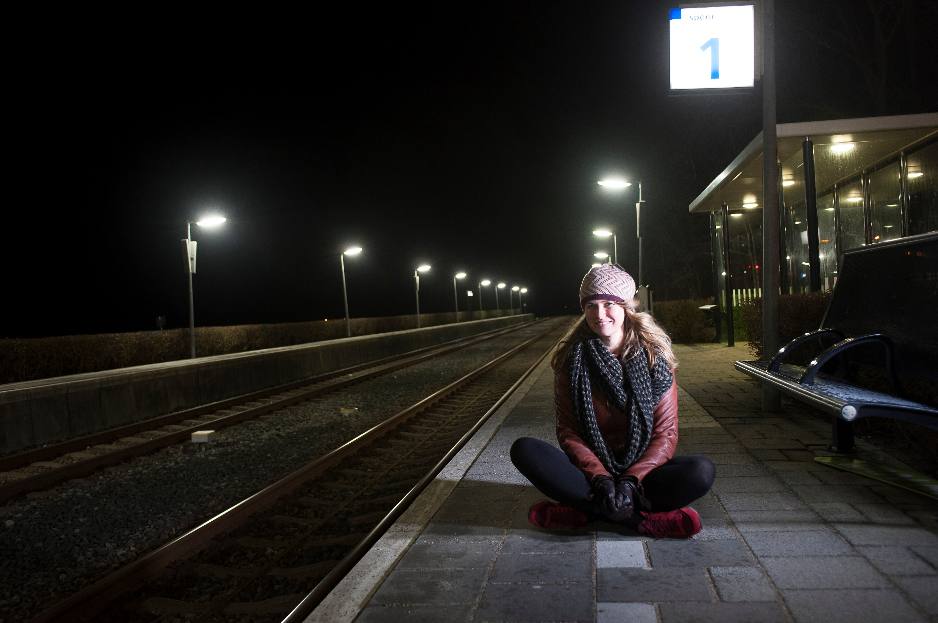
storytelling
The day has eyes and the night ears
Nynke-Rixt Jukema

Slide 2
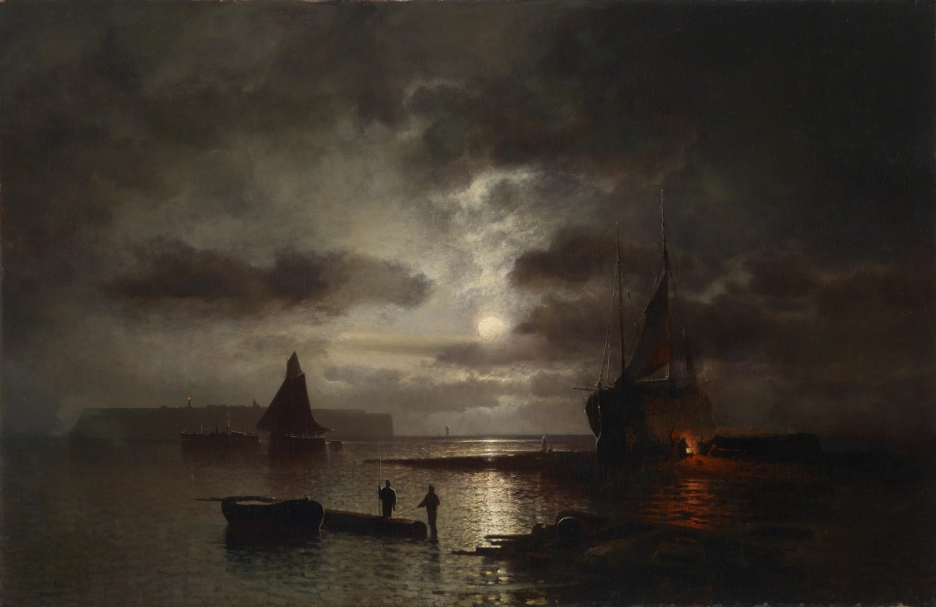
Mondnacht bei Helgoland, Julius Köhnholz, 1925

Slide 3
The night cannot be painted
It is much too dark for the human eye to distinguish anything.
To make a convincing night painting, the painter must have enormous powers of observation.
The day is neutral, but the night has personality.

Slide 4
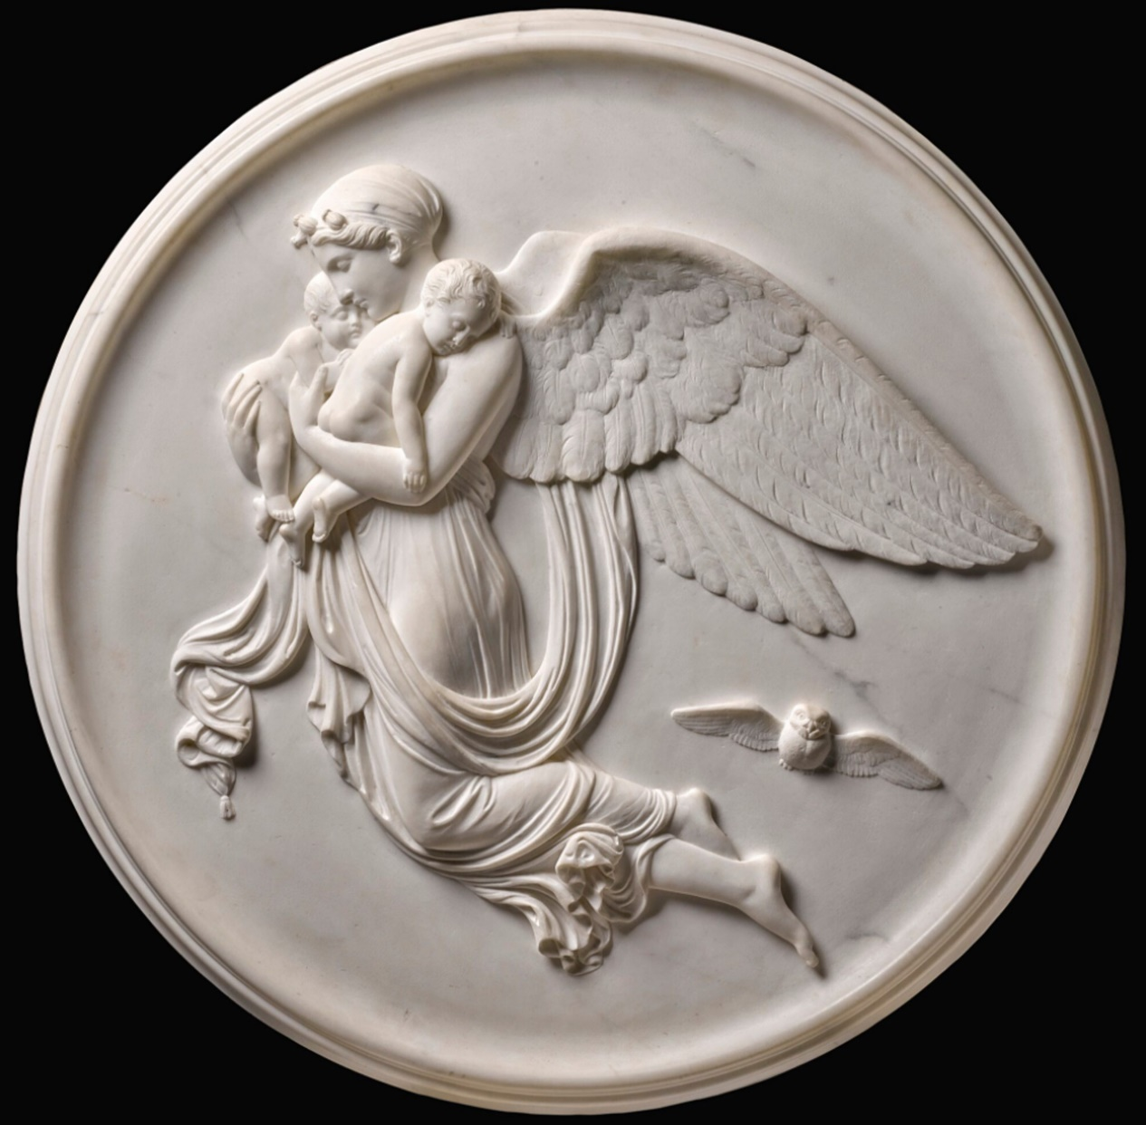
Night, Bertel Thorvaldsen, 1815

Slide 5
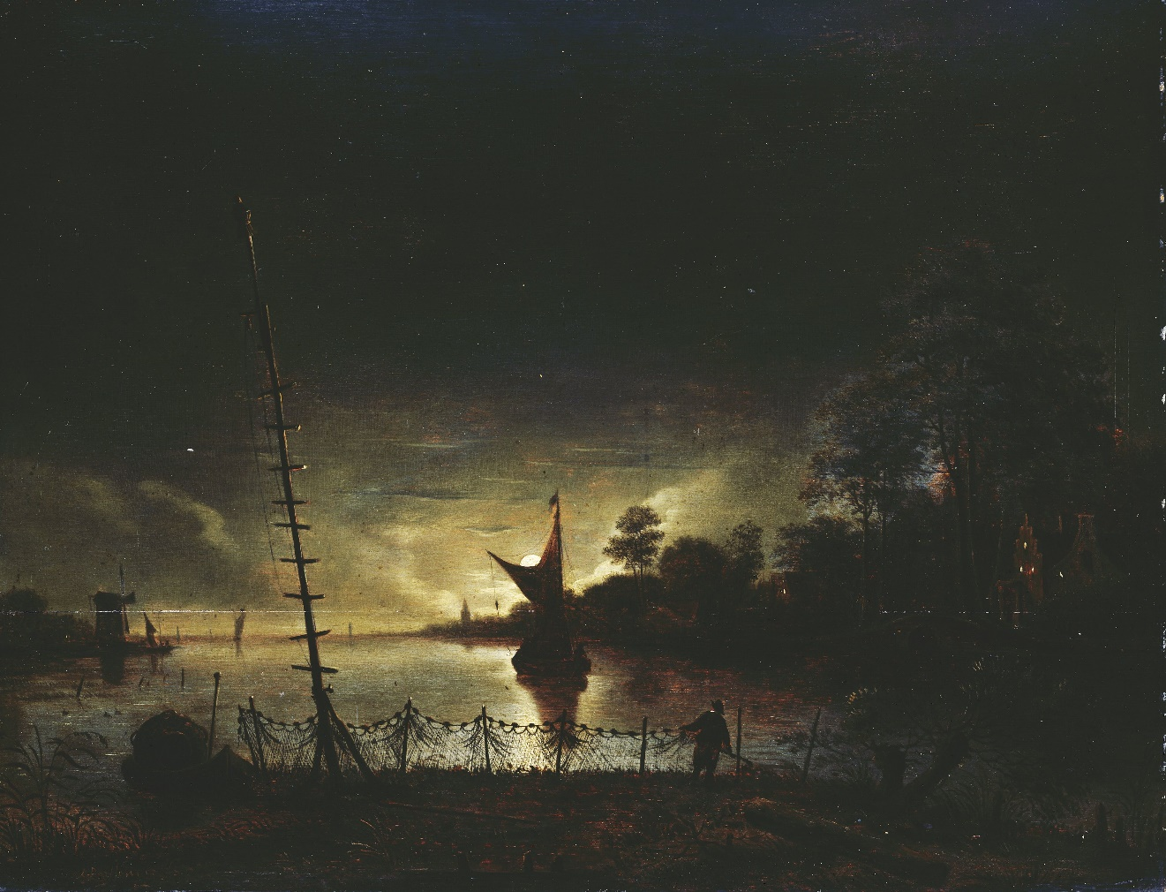
Landscape in moonlight, Anthonie van Borssom, 1640 - 1677

Slide 6
Why should we tell night stories to each other?

Slide 7
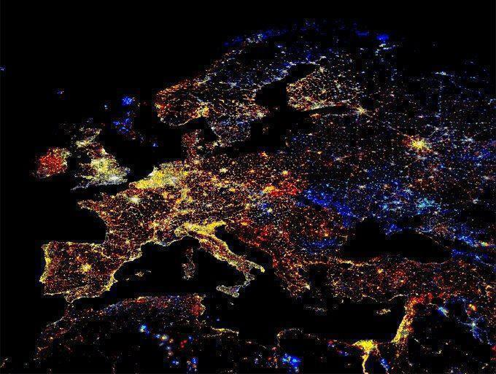

Slide 10
Waddenregion

Slide 11
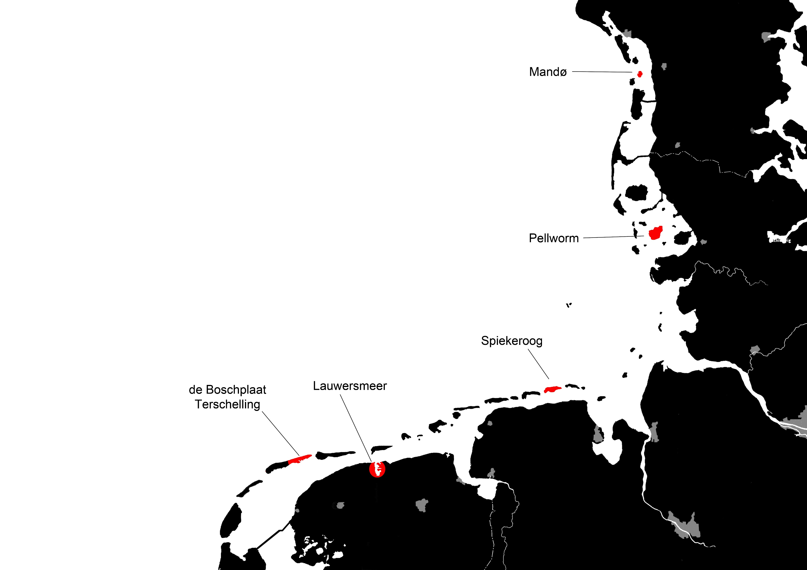
Dark sky parks in the Waddenregion

Slide 12
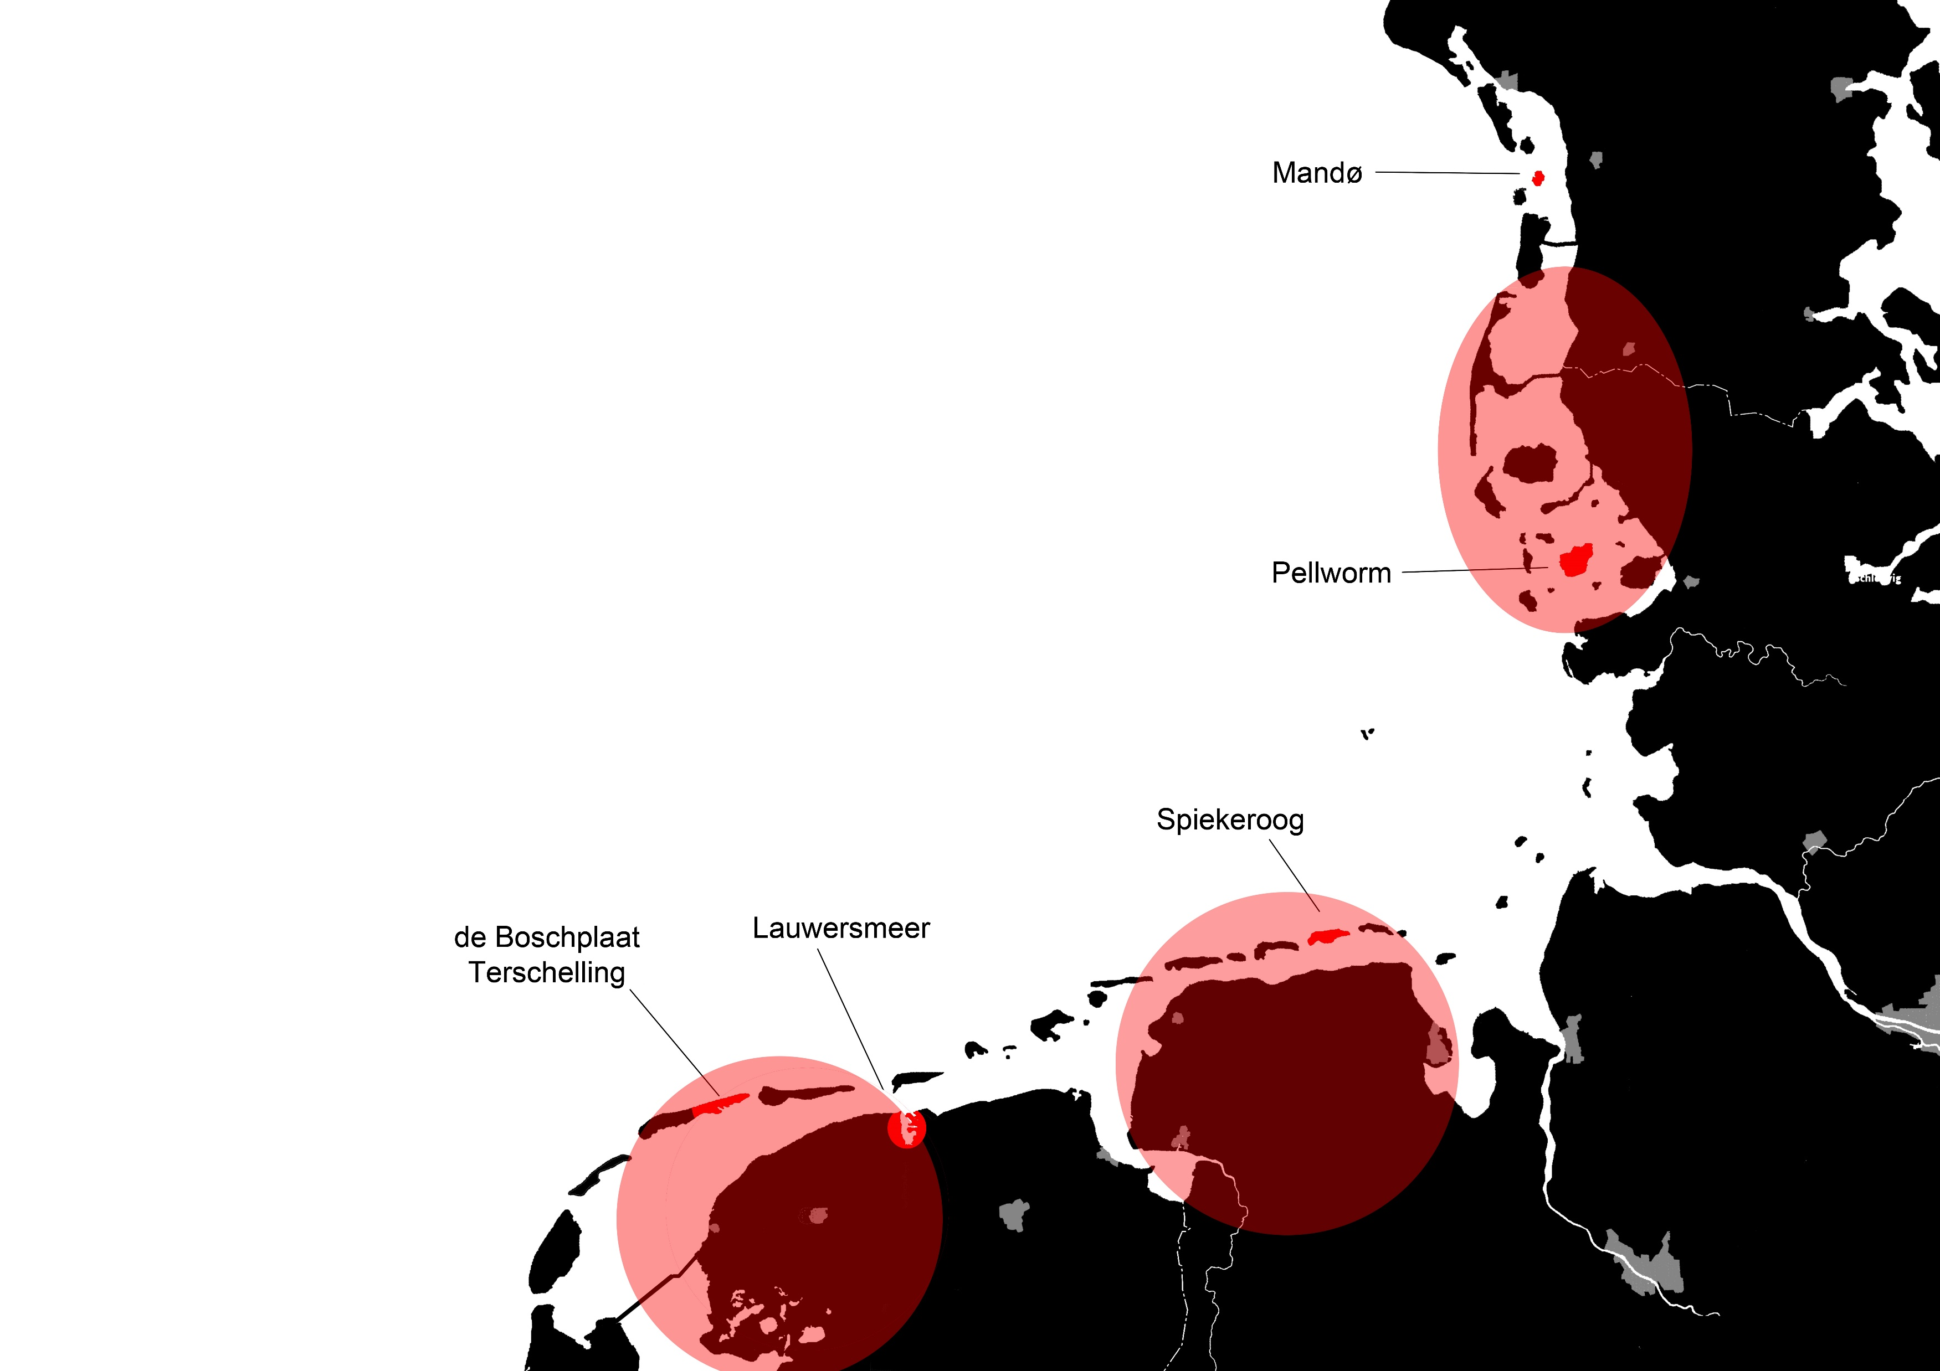
Frisian language in the Waddenregion (1600)
Find out if the stories also match?

Slide 13
How did people live in the evening and at night?

Slide 14
the rhythm of the night
Sidereal year: mid summer/winter night

Slide 15
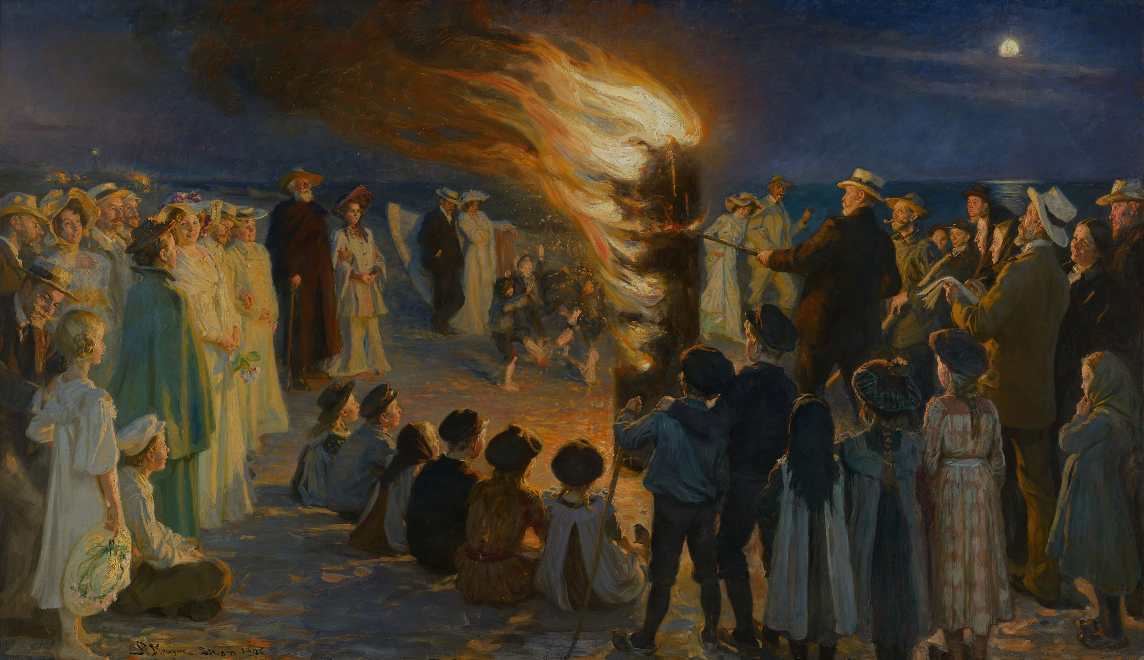
Midsummer Eve Bonfire on Skagen Beach, Peder Severin Krøyer, 1906

Slide 16
the rhythm of the night
Sidereal year: mid summer/winter night
lunar calendar: harvest moon, snow moon

Slide 17
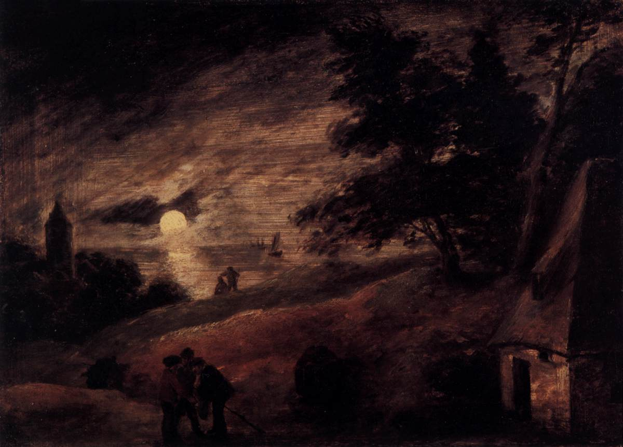
Dune Landscape by Moonlight, Adriaen Brouwer, 1635-1637

Slide 18
the rhythm of the night
Sidereal year: mid summer/winter night
lunar calendar: harvest moon, snow moon
Nighttime: sunset, lock up, candlelight, bedtime, midnight, the middle of the night, the crowing of the rooster, hour of the wolf and the dawn

Slide 19
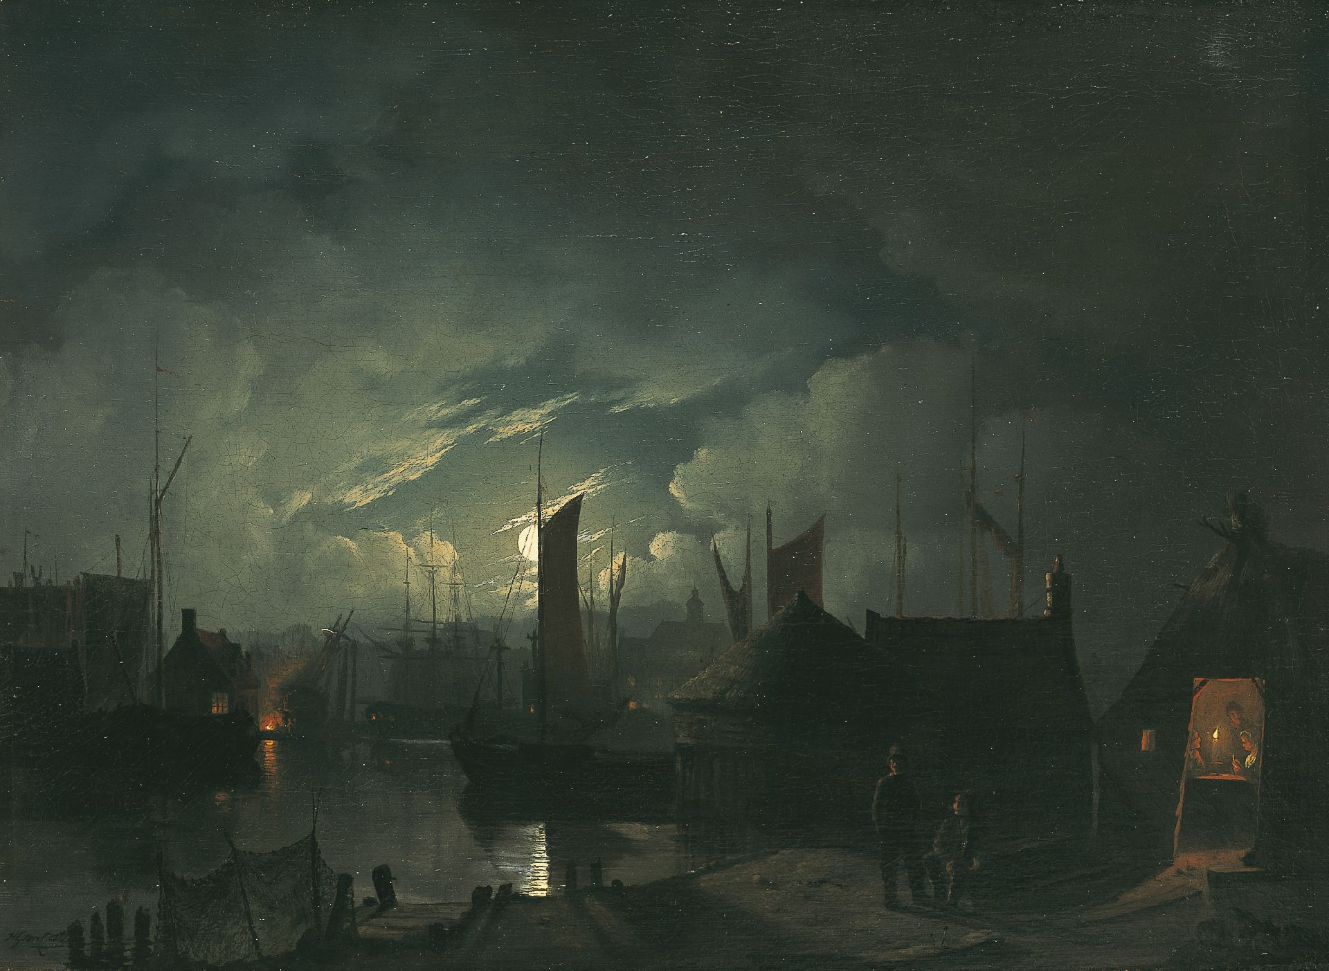
harbor view by moonlight, Hendrik Gerrit ten Cate, 1803-1856

Slide 20
nighttime activities
work: an economic necessity

Slide 21
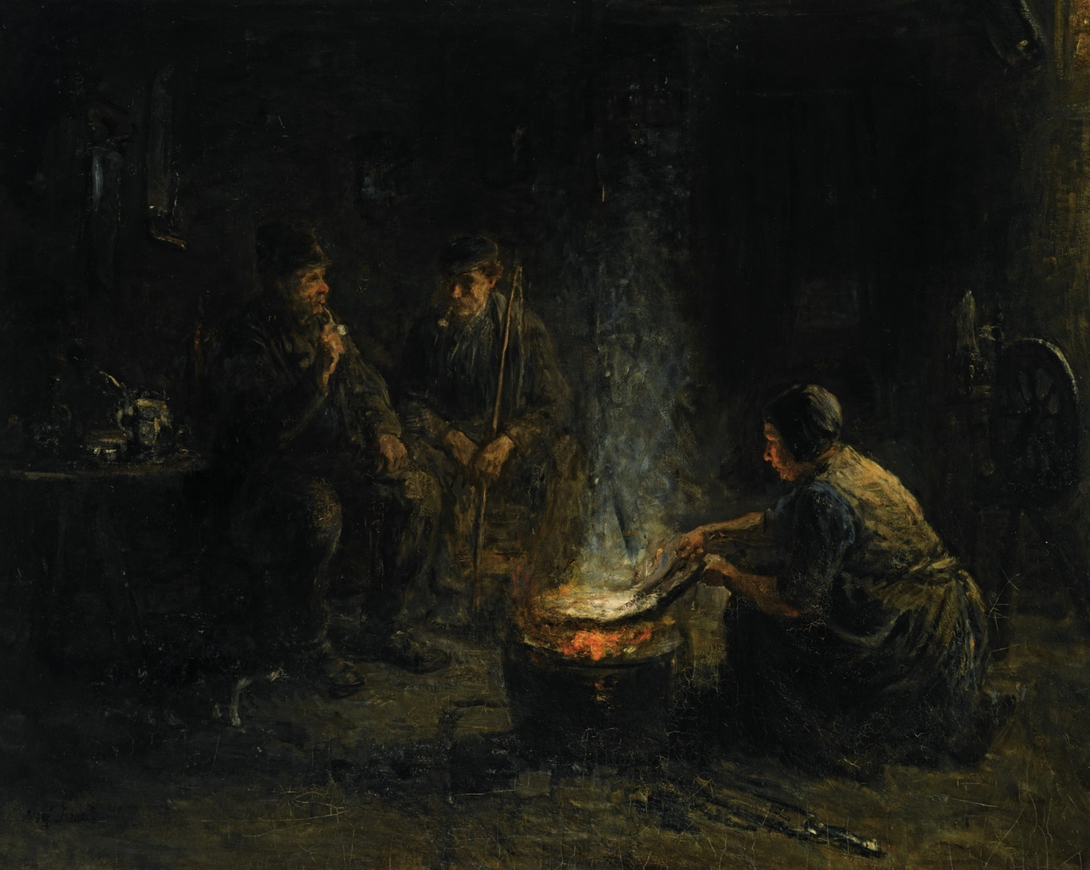
Preparing the meal, Jozef Israels, 1824-1911

Slide 22
Storytelling
To save valuable fuel, neighbors often worked around one lamp or torch at night.
During spinning and knitting, the main source of entertainment was the telling of fables, legends and stories about evil spirits.
The spoken word is all the brighter in the dark when the visible is not distracting.

Slide 23
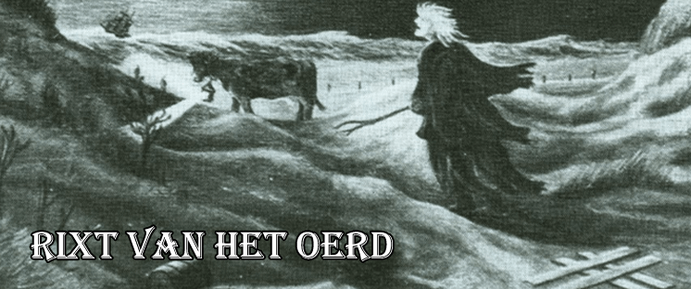

Slide 24
nighttime activities
work: an economic necessity
study: the day counts on our labor, the night on our thinking

Slide 25
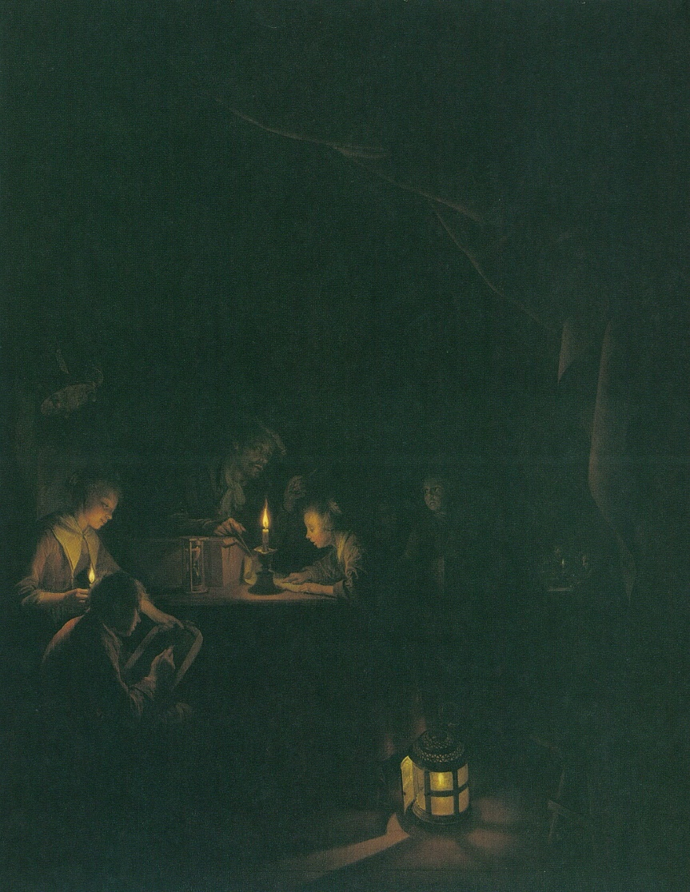
Evening school, Gerard Dou, 1660

Slide 26
Storytelling
People also looked at the moon and the stars to see what time it was.
forecasting the weather All weather types, from thunderstorms to frost, were predicted by meteorological omens in the evening sky.
about the stars and galaxies in the universe, but also the planets of the solar system.

Slide 27
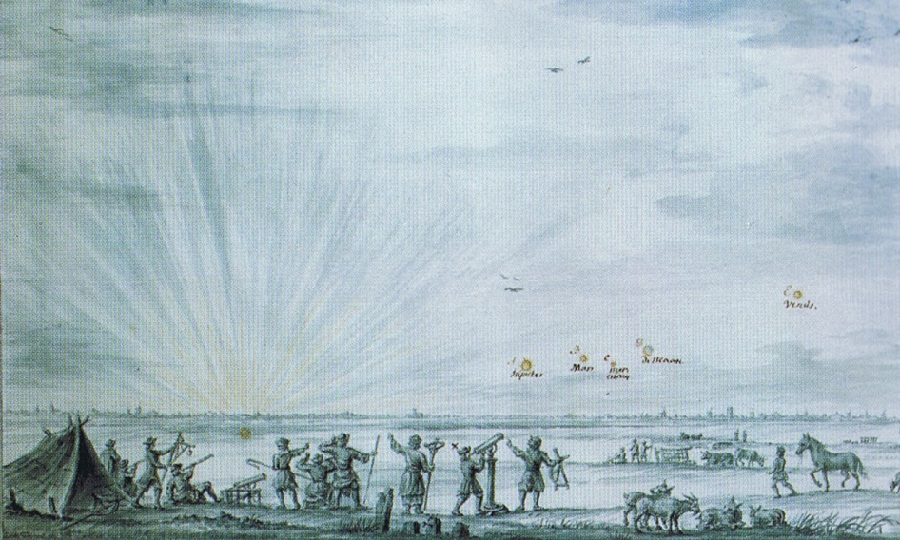

Slide 28
nighttime activities
work: an economic necessity
study: the day counts on our labor, the night on our thinking
reflection: the night brings advice

Slide 29
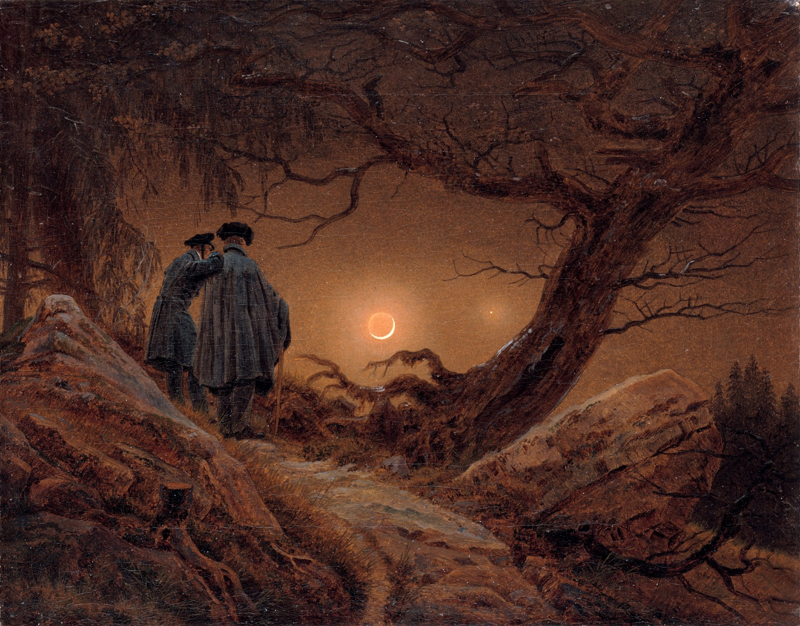
zwei manner in betrachtung des mondes, Caspar David Friedrich, 1819

Slide 31
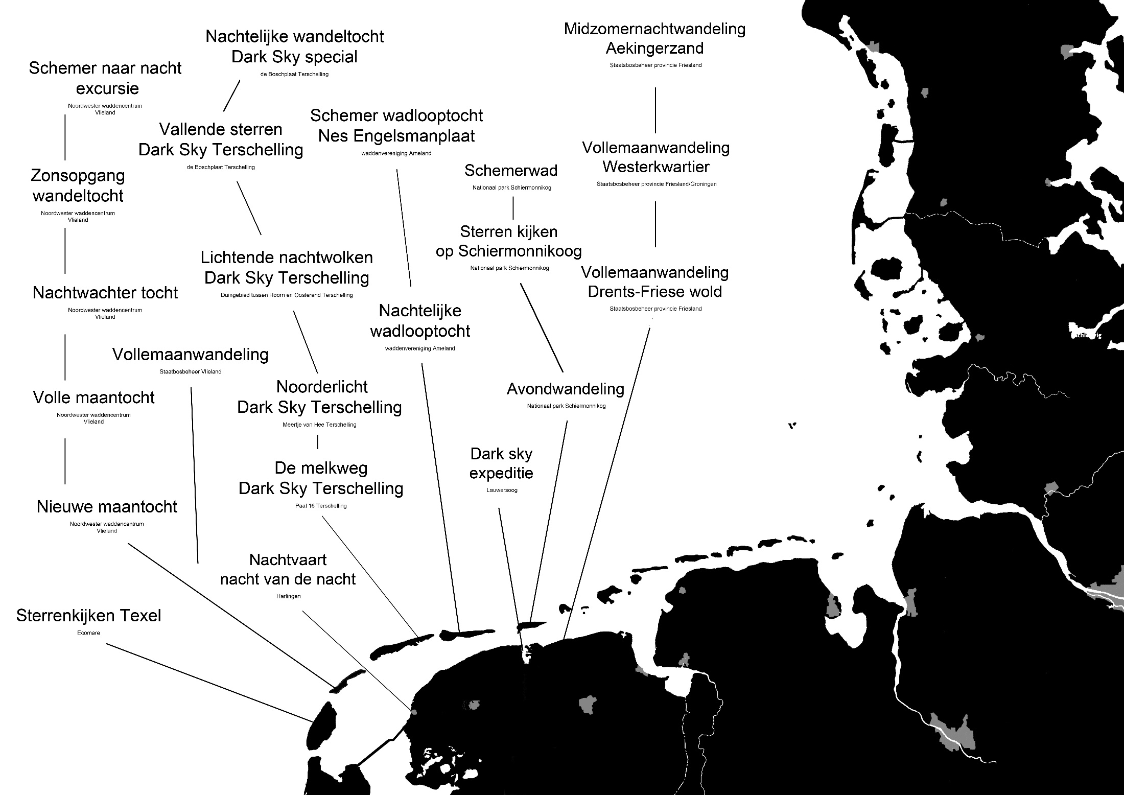

Slide 32
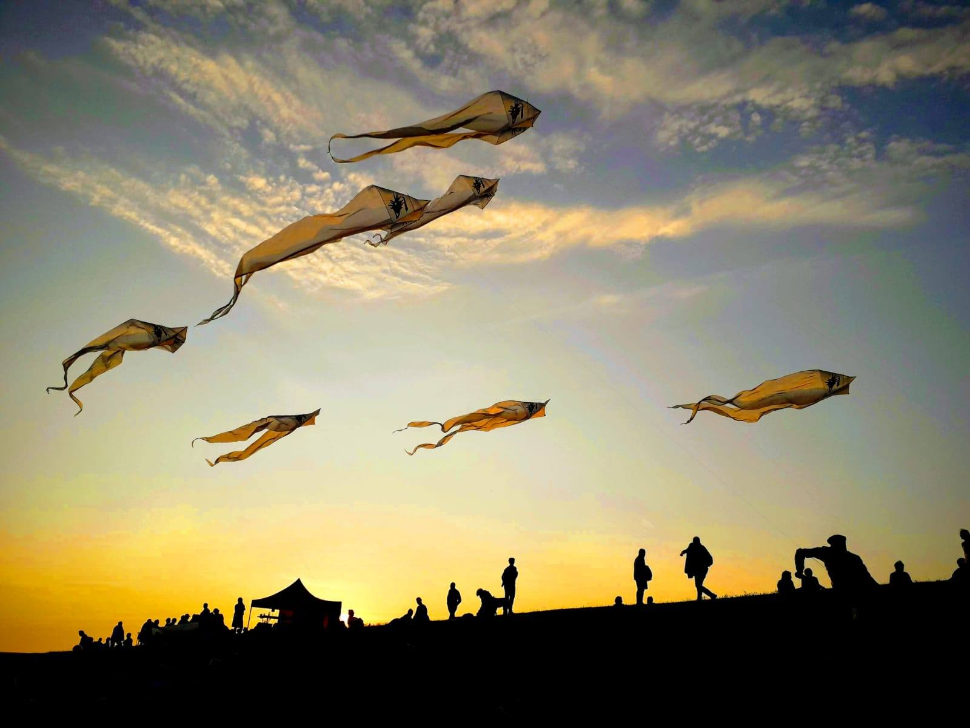

Slide 33
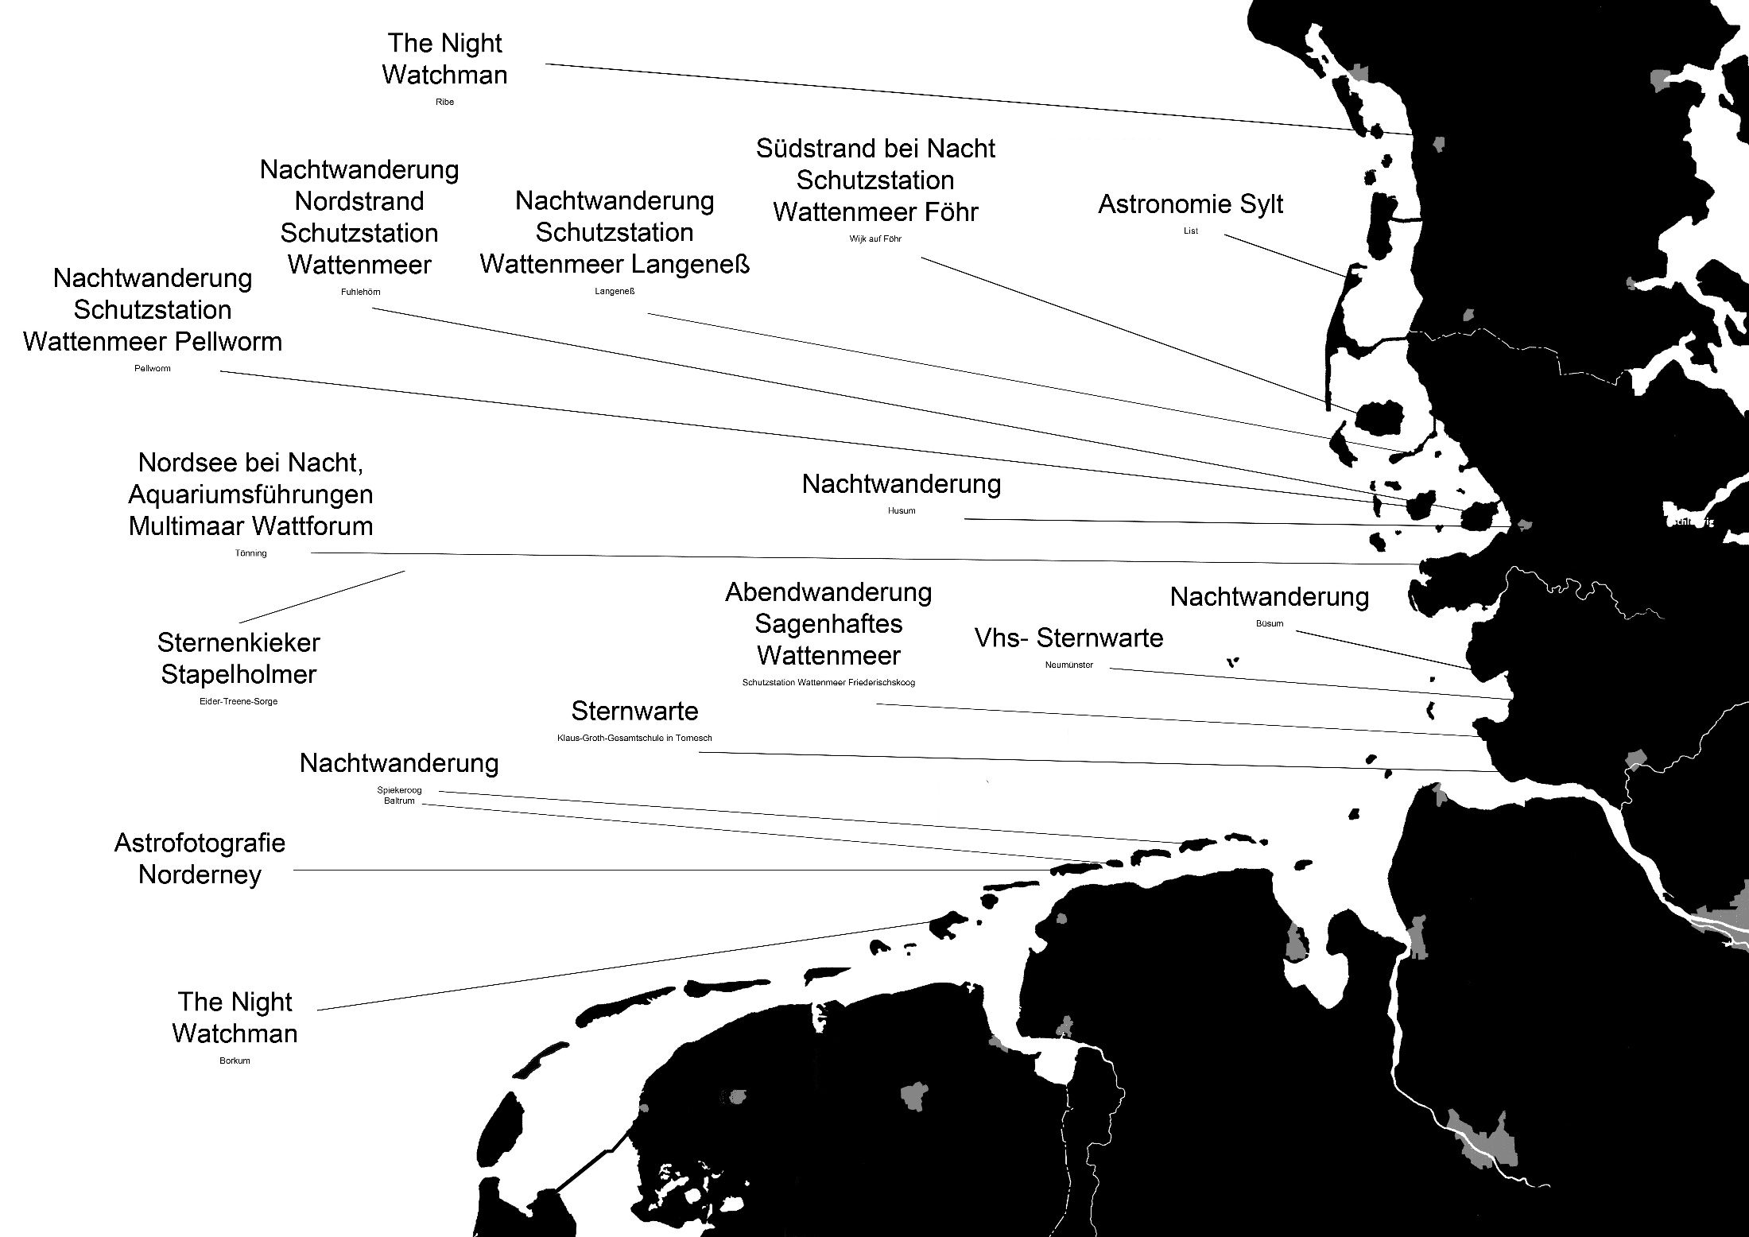

Slide 34
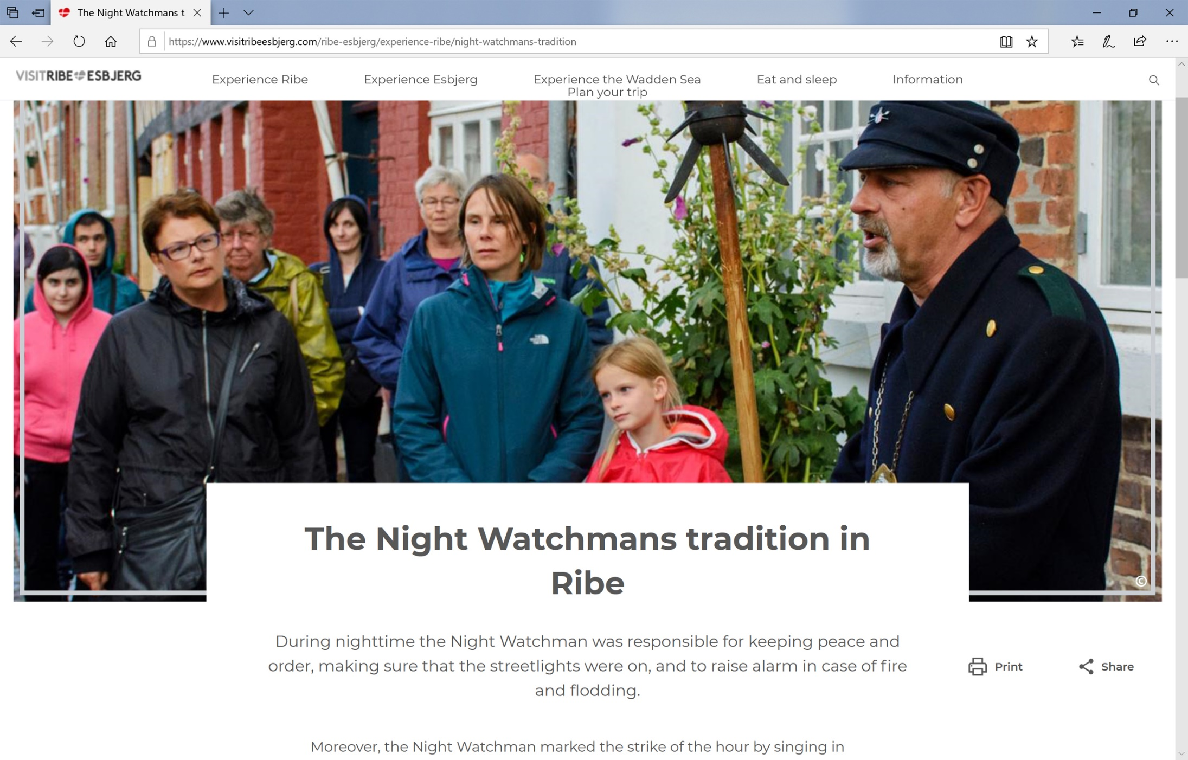

Slide 36
Main Goal:
Offering a welcoming dark landscape

