Slide 1
Improvement of the Ems estuary
How to create a resilient estuary
Dr. Petra Dankers
18 juni 2021

Slide 2
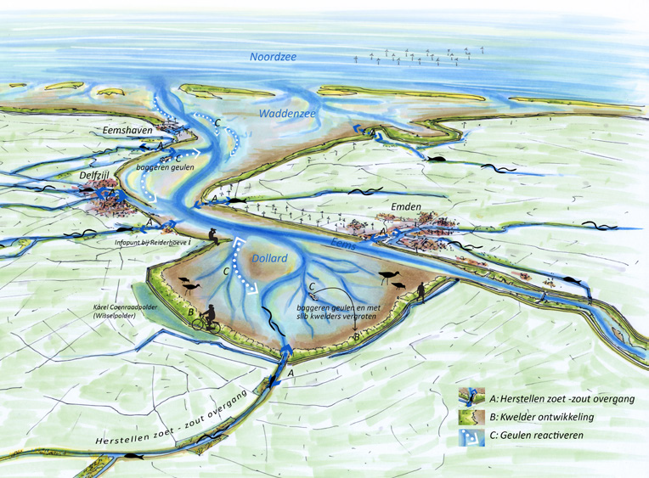
The setting
The Ems Estuary
Declining ecosystem
Lack of habitats
Turbidity

Slide 3
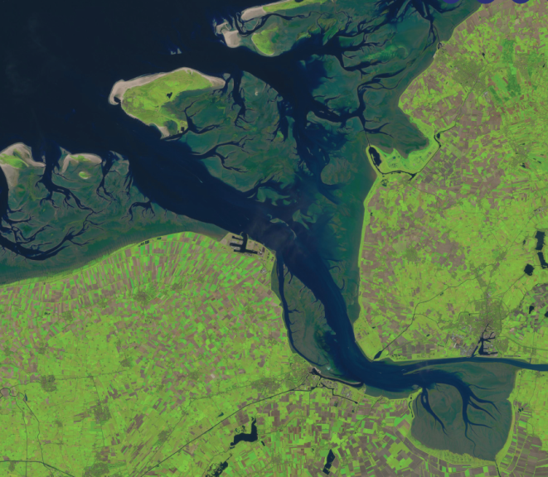
What’s going on in the estuary
Research of 2015 as starting point
Increasing sediment concentrations
Declining primary production
Issues in food chain
Deteriorating habitats
Difference in mouth, mid estuary and Ems river
At the same time: wish of economical development
European legislation: Natura 2000 and KRW
Start of recent research on morphological and ecological development
Understand the past to understand the future (Utrecht University)
Understand the reason behind change (Deltares, RWS)
Predictions towards 2100 including sea level rise (Deltares, RWS)

Slide 4
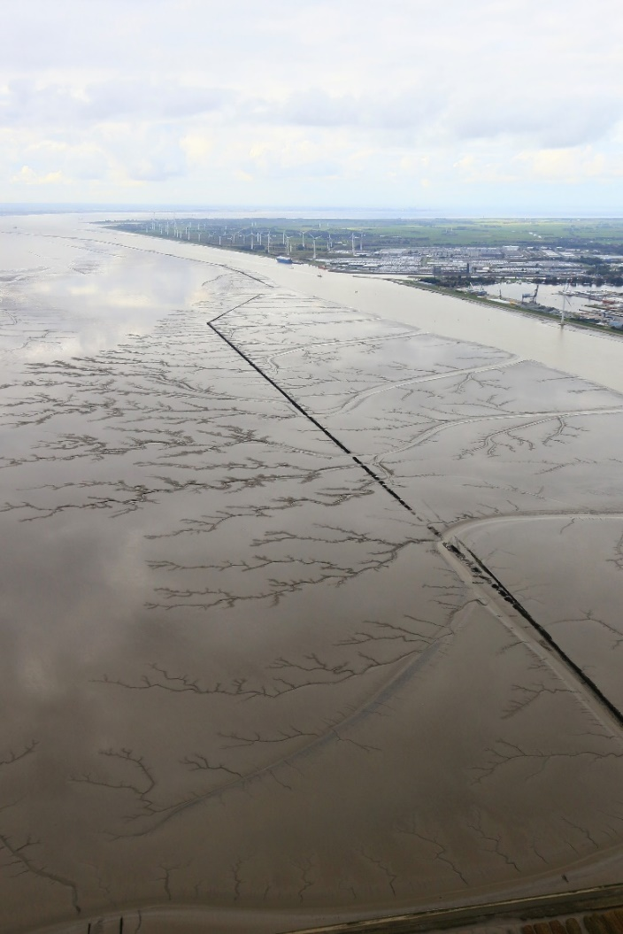
Latest insights on sediment concentration
Sediment concentrations in the estuary are not (yet) extremely high
But increasing trend, since 1954 deepening and ongoing dredging
Ems river concentrations are extremely high
Since 2012 relatively stable in the mouth and mid estuary (following the Wadden Sea)
Dollard and Ems remain an issue

Slide 5
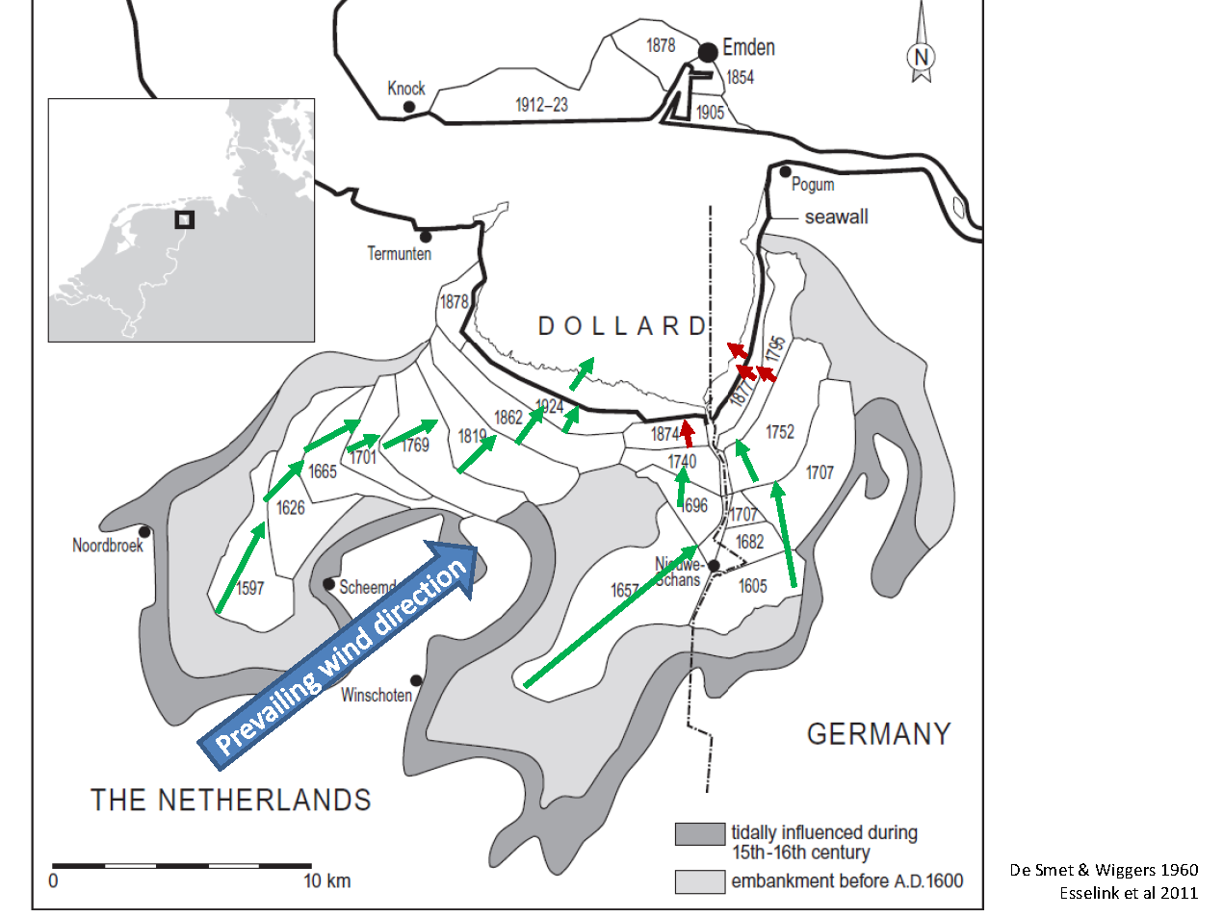
Reasons behind high sediment concentrations (Van Maren, 2015 and 2016)
Comes with the type of system (natural)
Fairway deepening
Dredging and dispersion of fines
Decrease of intertidal areas and loss of land/water boundaries

Slide 6
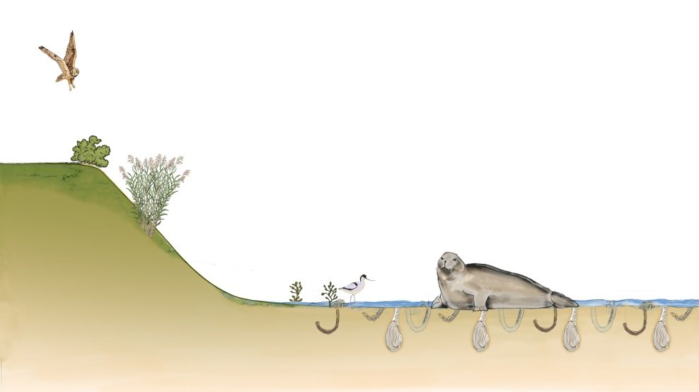
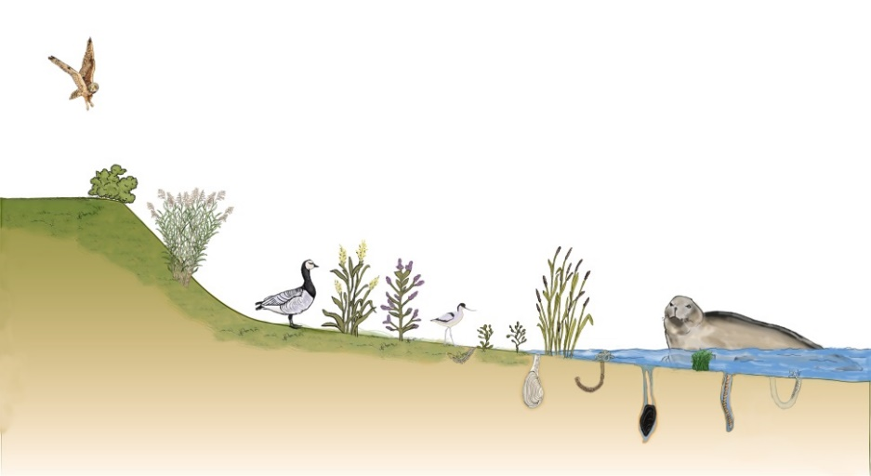
Effect changing system on ecology (Van der Zee, 2019)
High sediment concentrations but also:
Sea level rise
Changing temperature
(relation between habitats, food availability, presence of species is complex, many unknowns)
Resulting in:
Decrease specific habitats
Changing base of food chain (benthos from shellfish to worms, SIBES data)
Changing birds and fish
Business as usual
Desirable Future

Slide 7
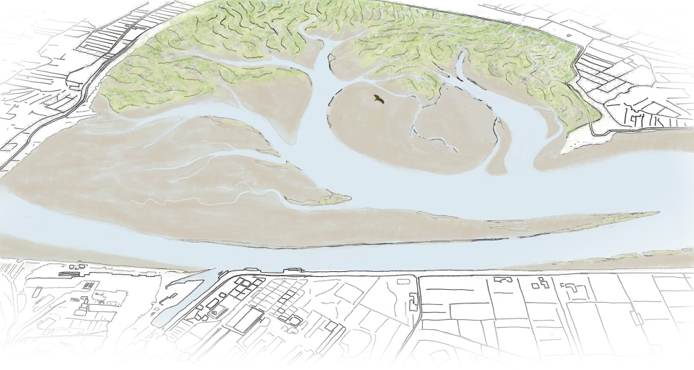
What does this mean and which steps to take
Sea level rise and a very turbid Ems river are given
The effects (increasing turbidty estuary, loss of habitats, decrease food availability) can be reduced
Ems river needs German solutions(Tidesteuerung, …, …)
Learn from pilots (no regret measures)
Improve sedimentation, increase sedimentation areas, increase land/water boundaries

Slide 8
Examples
Dollard project
Marconi Delfzijl
Measuring campaign

Slide 9
Dollard project
Increasing sedimentation in the Dollard (MIRT study RWS by RHDHV)

Slide 10
Marconi Delfzijl - Research on wetland development
Science
How can we build a salt marsh from scratch
Starting height, material, protection, practical issues, non-standard brushwood groynes
Which design works best for a natural development
Percentage of mud
Vegetation
Shelter
height

Slide 11
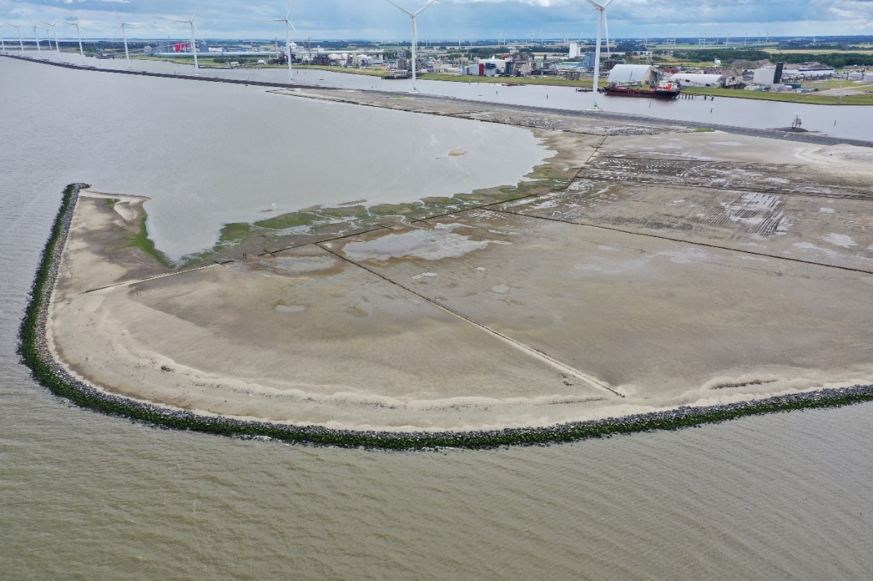

Slide 12
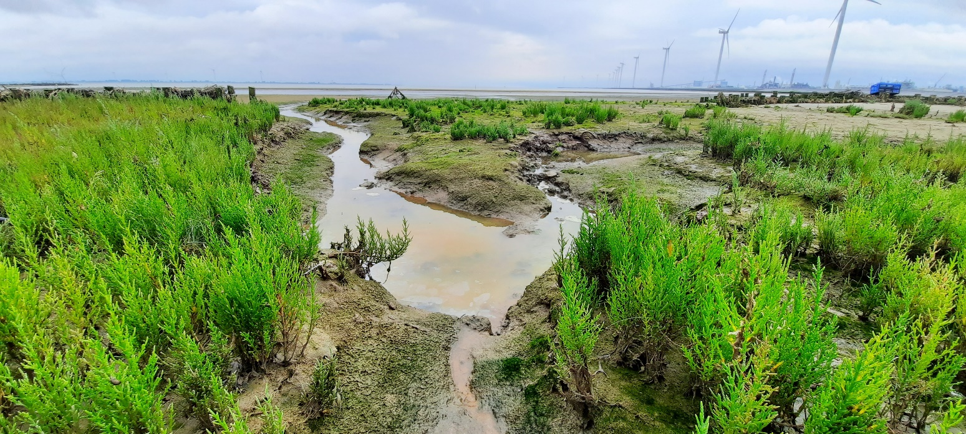
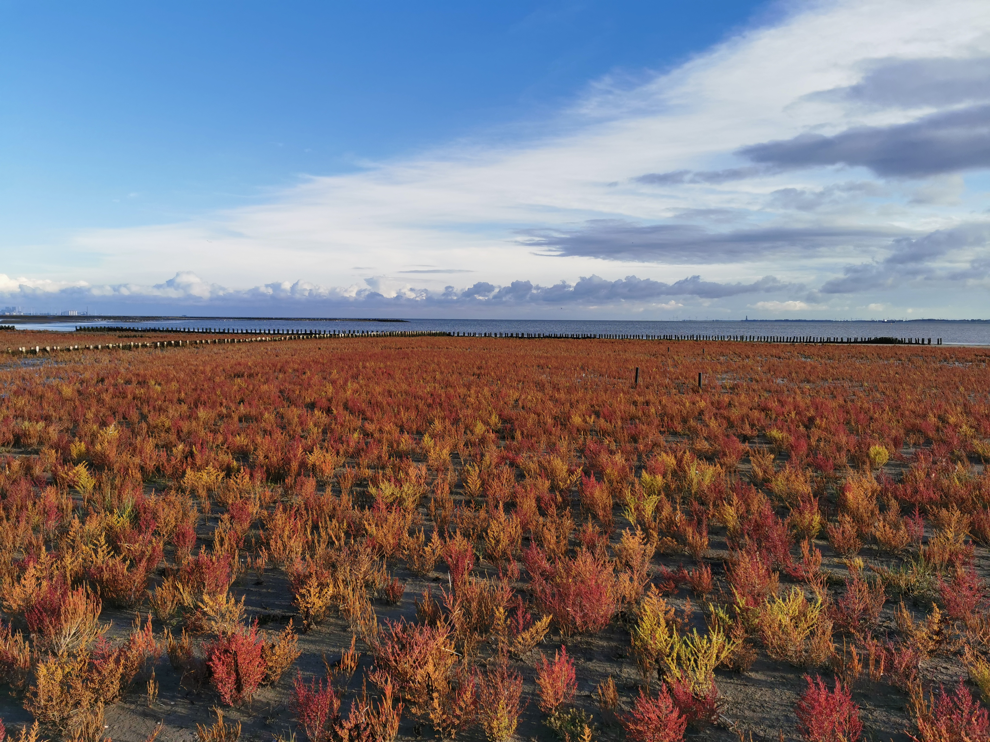
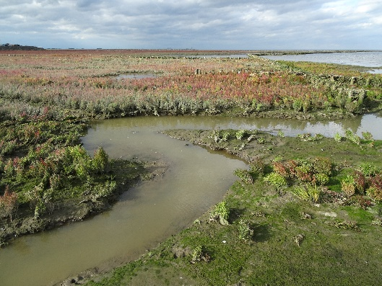
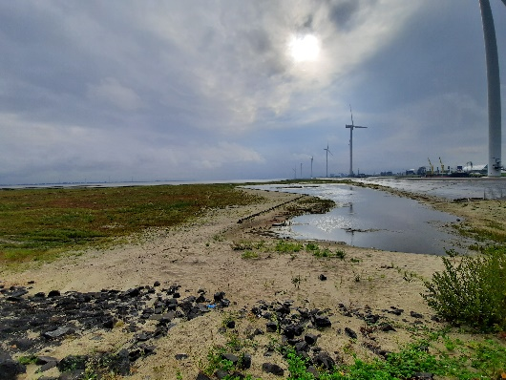
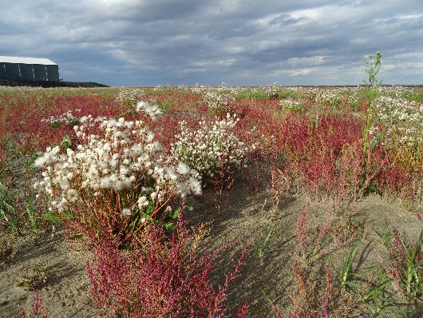

Slide 13
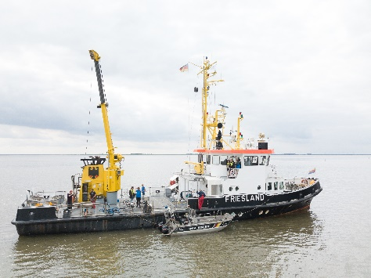
Working together with Germany
Common knowledge base
Understanding the interaction between river and estuary
Coming to a joint approach on improving the Ems system

