Slide 1
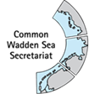
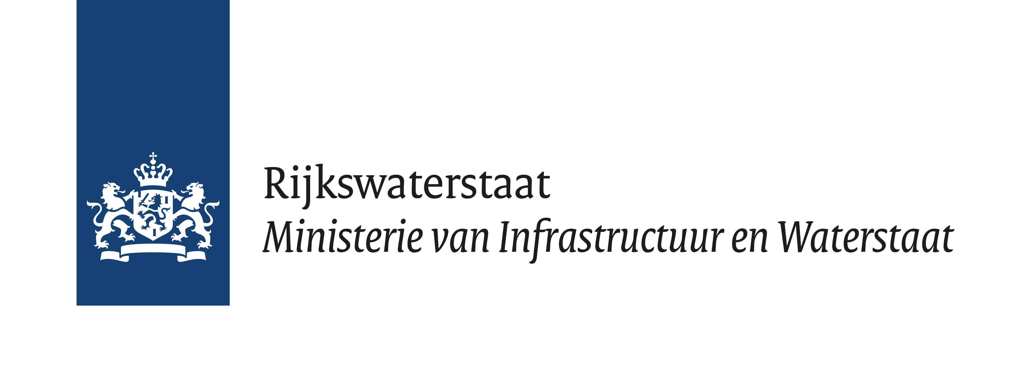
3rd Webinar Sediment Solution
18th of June 2021 Towards a Wadden Sea Sediment solutions Community of Understanding
09.30 | Welcome and introduction | Mindert de Vries (Deltares)
09.40 | Development of the community of understanding | Wim Schoorlemmer (PRW) & Cristina Nazzari (CWSS)
09.55 | ‘On sediment-ecology interactions in the Wadden Sea ecosystem’ | Hein Sas (PRW)
 | Biological effects of suspended sediment in sub and intertidal areas | Petra Dankers (RHDHV)
 | Unstructured modelling of the Ems and Elbe estuaries | Johannes Pein (Helmholtz-Zentrum Hereon)
 | Short wrap-up | Hein Sas
11.05 | Break
11.20 | ‘Sediment application for coastal defence and other uses’ | Gerald Herrling (Universität Kiel)
 | Retaining sediment as foundation for ecosystem services of coastal vegetation | Oliver Lojek (Leichtweiß-Institute TU Braunschweig)
 | Application of surplus Wadden Sea sediment on land. | Marcel van den Heuvel (Van Oord)
 | Short wrap up | Gerald Herrling
12.30 | Future course and possible initiatives | Michiel Firet (PRW)
12.35 | Wrap up and closure | Mindert de Vries
Microphone on mute Use the chat for questions and reactions

