Slide 1
Lichtimmissionen, Artenschutz und Bürgerbelange
Policies for more effective measures in
Night Scape Protection based on the experience in the DSP Rhön/DSC Fulda
Sabine Frank, Landkreis /Council Borrough of Fulda,
Landkreis Fulda, Fachstelle Sternenpark UNESCO Biosphärenreservat Rhön wissenschaftliche Begleitung: Dr. Andreas Hänel
Arbeitskreis Naturschutz Landkreis Fulda

Slide 2
Notes:
Deshalb hat die Rhön 2014 Auszeichnung erhalten – SILBER –
Wir sollten gemeinsam GOLD anstreben.

Slide 3
Rhön Mountainrange

Slide 4
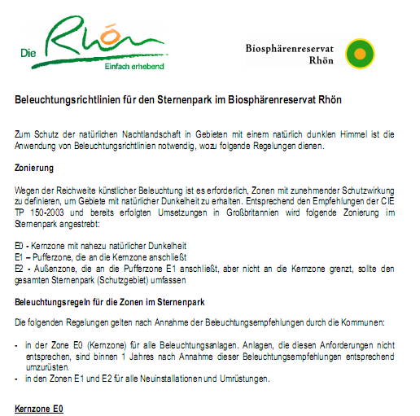
Lighting guidelines adopted by parliamentary resolutions
in the municipalities (2012 - 2014)
(reconciled beforehand with the local energy suppliers)

Slide 5
Welche Anforderung an umweltverträglichere Beleuchtung kann es geben?
Erkenntnis, dass Dunkelheit der Nacht ein natürlicher Zustand ist.
Abweichungen davon sollten so gering wie möglich sein.
3. Vorschläge?
…auf alle Fälle immer blendfrei und rücksichtsvoll!

Slide 7
Notes:
Deshalb hat die Rhön 2014 Auszeichnung erhalten – SILBER –
Wir sollten gemeinsam GOLD anstreben.

Slide 8
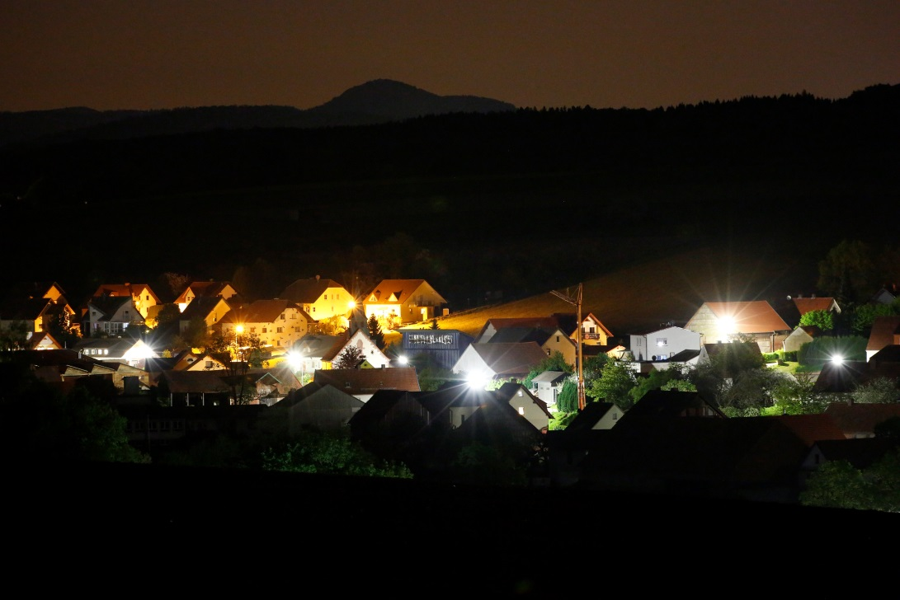
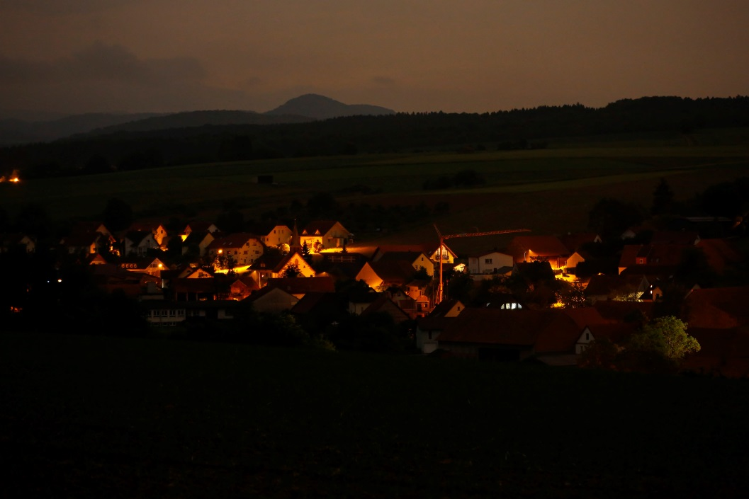
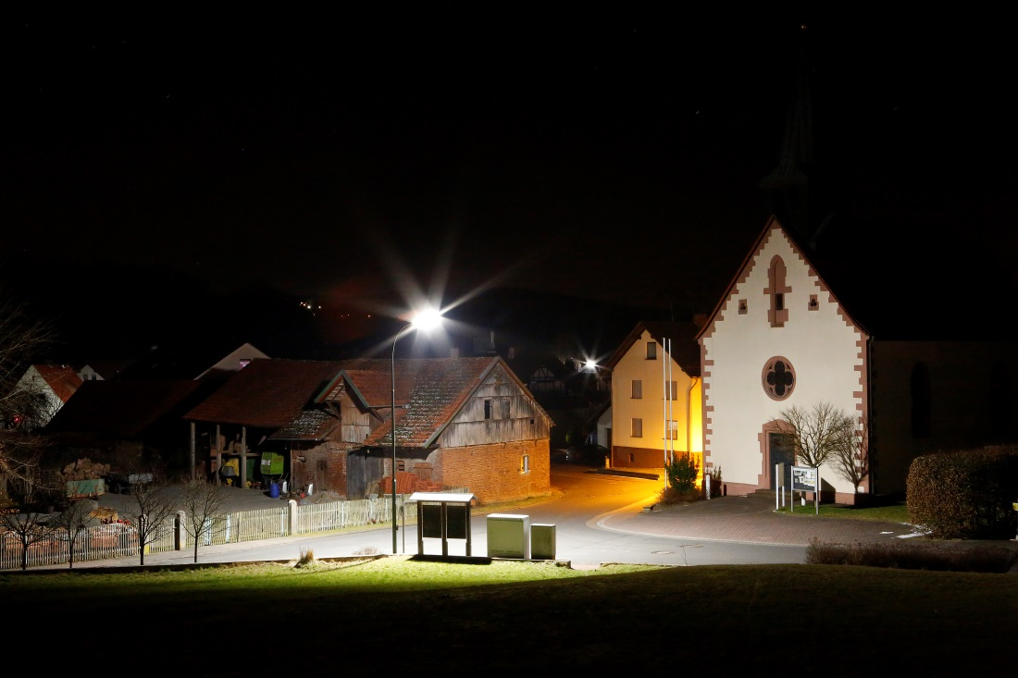
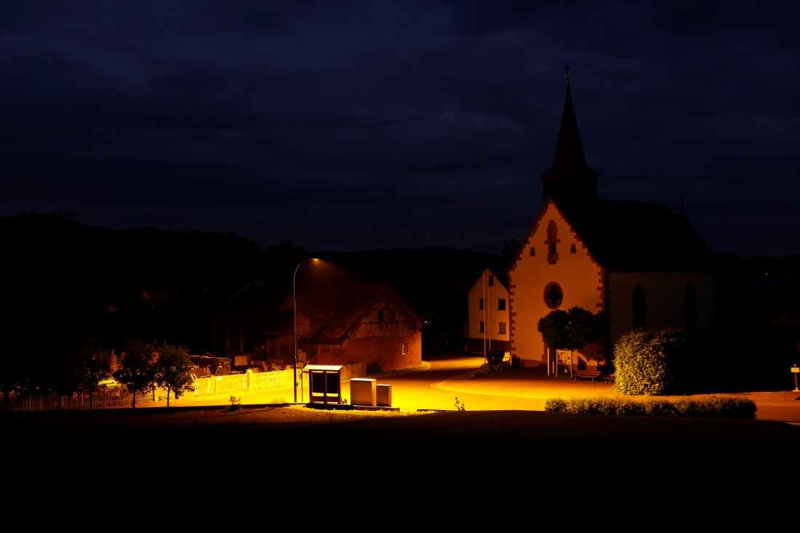
Best practice Silges: Umrüstung von Peitschenleuchten auf voll-abgeschirmte Amber-LED.
Foto: A. Mengel
Notes:
Umrüstung in Silges…. Vorher nachher…

Slide 9
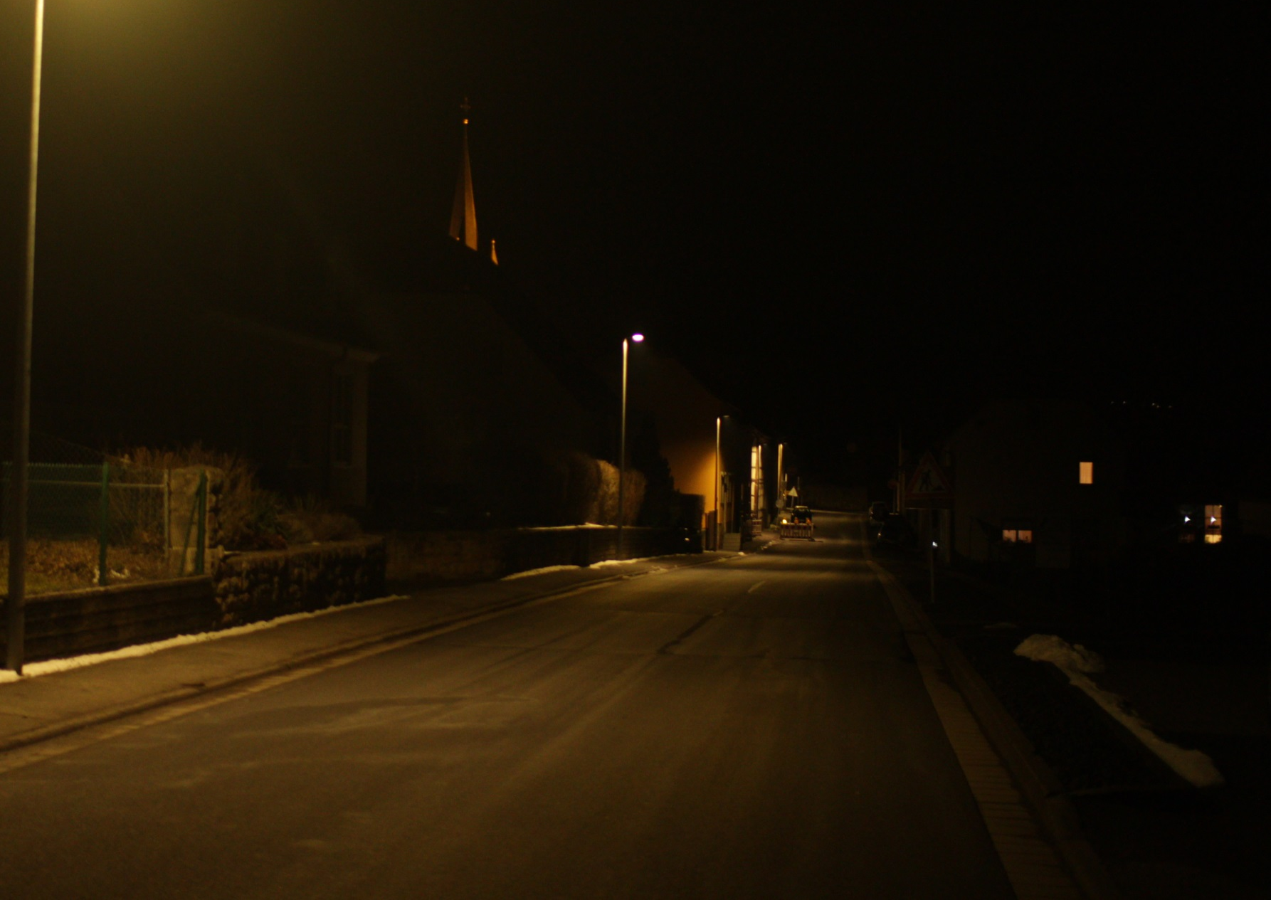
Umrüstung auf 3000 K, Bastheim – Reduzierung in der Nacht

Slide 10
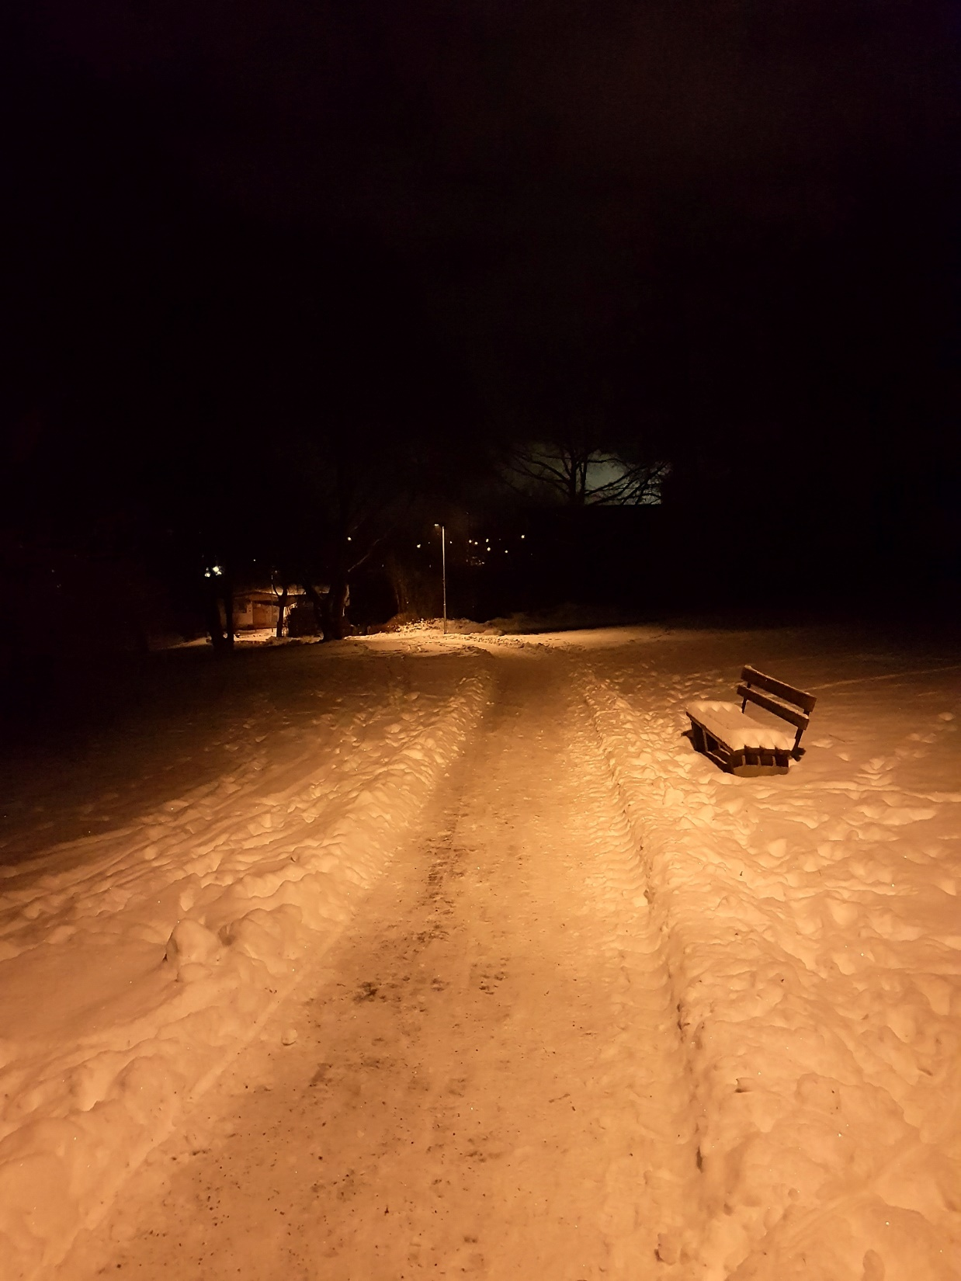
Fulda
2200 K

Slide 11
www.spektrum.de

Slide 12
Future Light:
Avoiding light immissions via legally effective policies!
PAST
FUTURE
Improving Darkness

Existing Luminaires:
Voluntary or funded conversion and optimization
!Beware: Right of Continuance!!!
Specification for Avoidance in:
Funding Guidelines
Tender Documents
Property Purchase Contracts
Land use plan
Planning Permission

Slide 13
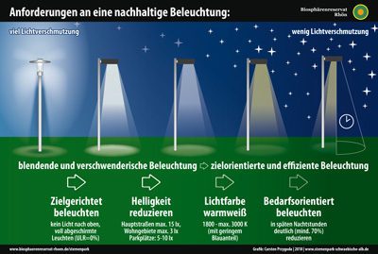
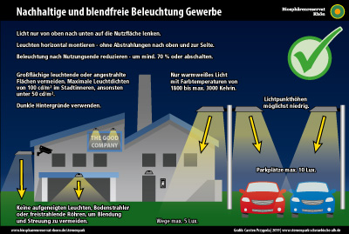
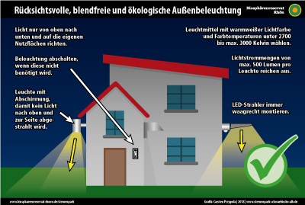
Define technical specification 2. Develop planning aids

Slide 14
Prevention in advance -
Binding specifications in the land purchase agreement
Avoidance/reduction of light immissions In order to avoid any nuisance for the people in the districts of Neuhof, the buyer undertakes, that he will permanently ensure that no light immissions, or as few as possible, emanate from his property. In the sense of sustainability and "the protection of the night from avoidable light immissions". the municipality of Neuhof refers to the "Planning aid for companies and municipalities: Environmentally Compatible Lighting at Workplaces, Parking Lots and Advertising Facilities", published by the UNESCO Biosphere Reserve Rhön, and the brochure "Nachhaltige Outdoor Lighting", published by the Hessian Ministry for the Environment, Climate Protection, Agriculture and Consumer

Slide 15
Prevention in advance – Funding and Call for Tender guidelines:
Specify requirements for the avoidance of light immissions
What role do requirements for more environmentally friendly lighting play?

Slide 16
Best Practice Beispiel: Adjustment of the documents
for funding floodlights in sports
Notes:
Deshalb hat die Rhön 2014 Auszeichnung erhalten – SILBER –
Wir sollten gemeinsam GOLD anstreben.

Slide 17
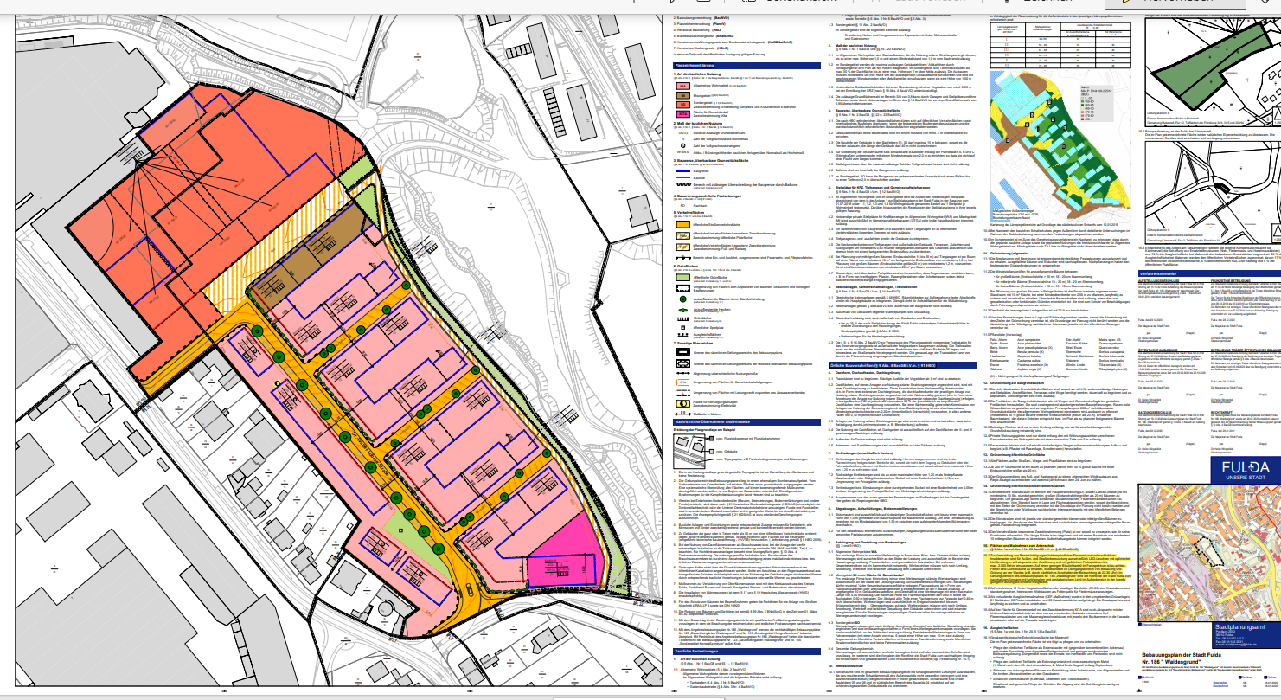
Prevention in advance: Binding Specifications in
land development plan and building permissions
Legal Basis for Binding Specifiations a.o.
(acc. German Building Code Baugesetzbuch:
§ 9 Abs. 1 Nr. 20 BauGB und
§ 9 Abs. 1 Nr. 24 BauGB

Slide 18
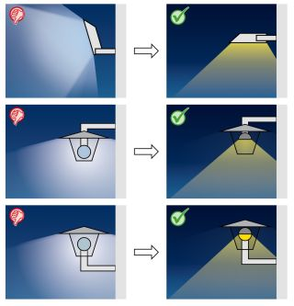
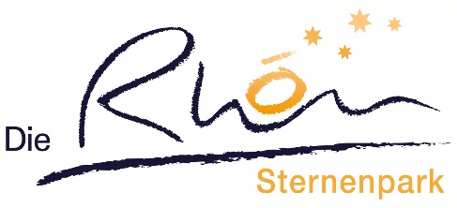
Planning Aids and Summary of Suggestions for Policies can be downloaded here:
https://biosphaerenreservat-rhoen.de/sternenpark and
Dark Sky - Initiative gegen Lichtverschmutzung
…
Thanks for Attention….

