Slide 1
Tom Axelsen
Inspiring a community about darkness

Slide 2
Møn and Nyord - The basics
Two islands, with 9235 locals
218 km²
Major city – Stege, 3786 citizens
Major income from farming and tourism
1236 public owned street lamps
Dark Sky Møn – The working group

Slide 3
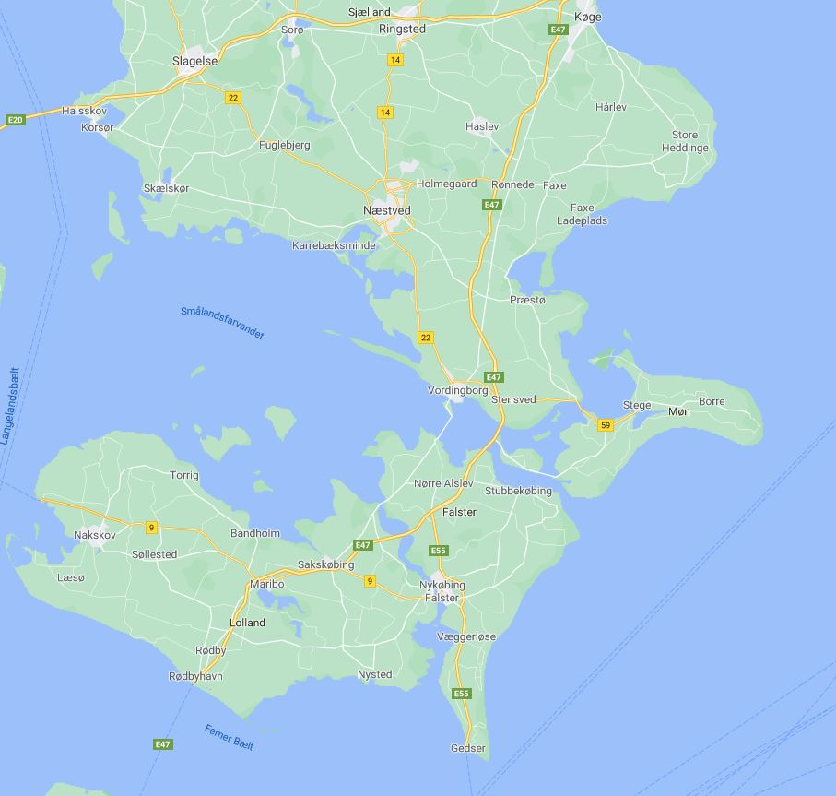
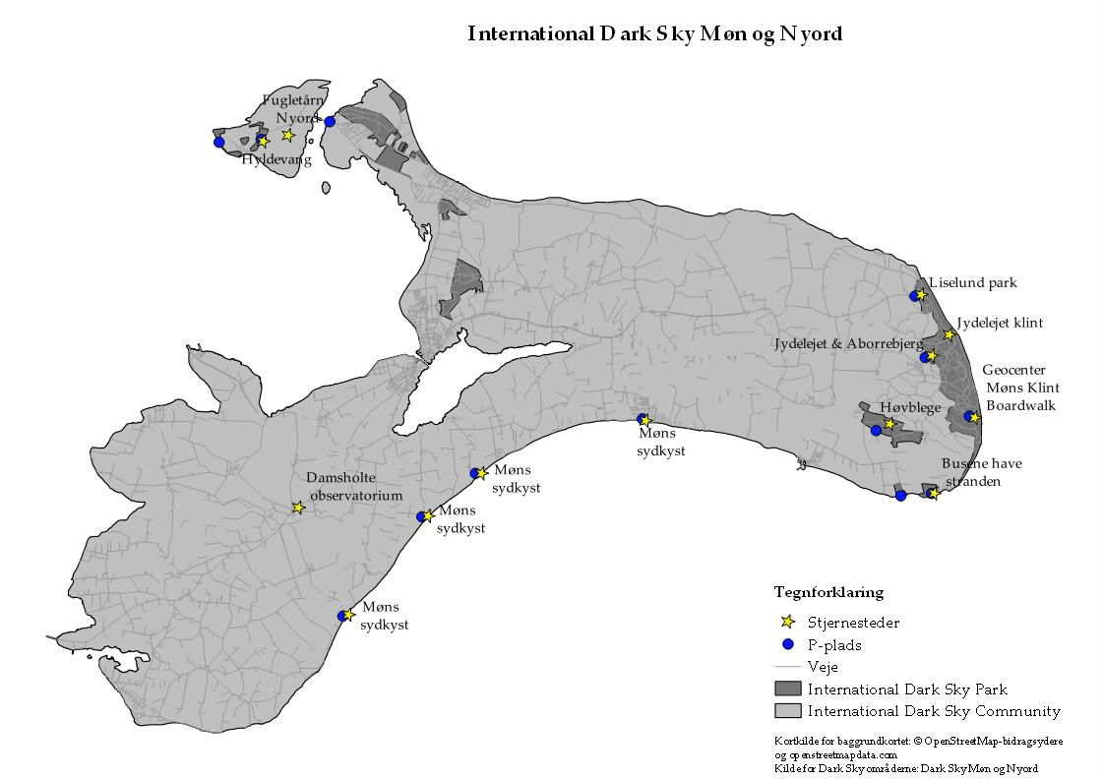
Møn and Nyord - The Areas

Slide 4
Inspiring people – How?
Bottom – Up
Talking to their heart and inspire
Proudness
Involvement
Happenings
Information

Slide 5
Status today
Municipality is responsible for the certifications
Information out of balance, focused on tourism.
”Forgotten” is conservation of darkness.
The progress towards better darkness has come to a halt.

Slide 6
Lessons learned
Strong policies
Strong commitment
Information, and a lot of it!
Involvement
Nation wide laws agains lightpollution

Slide 7
Questions?

