Slide 1
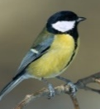
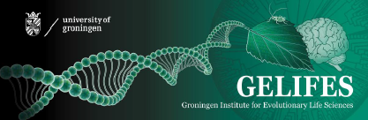
Webinar "Erlebe die Finsternis", April 2021
The dark side of light –
Darkness matters for nature and people
Barbara Helm
University of Groningen, NL

Slide 2
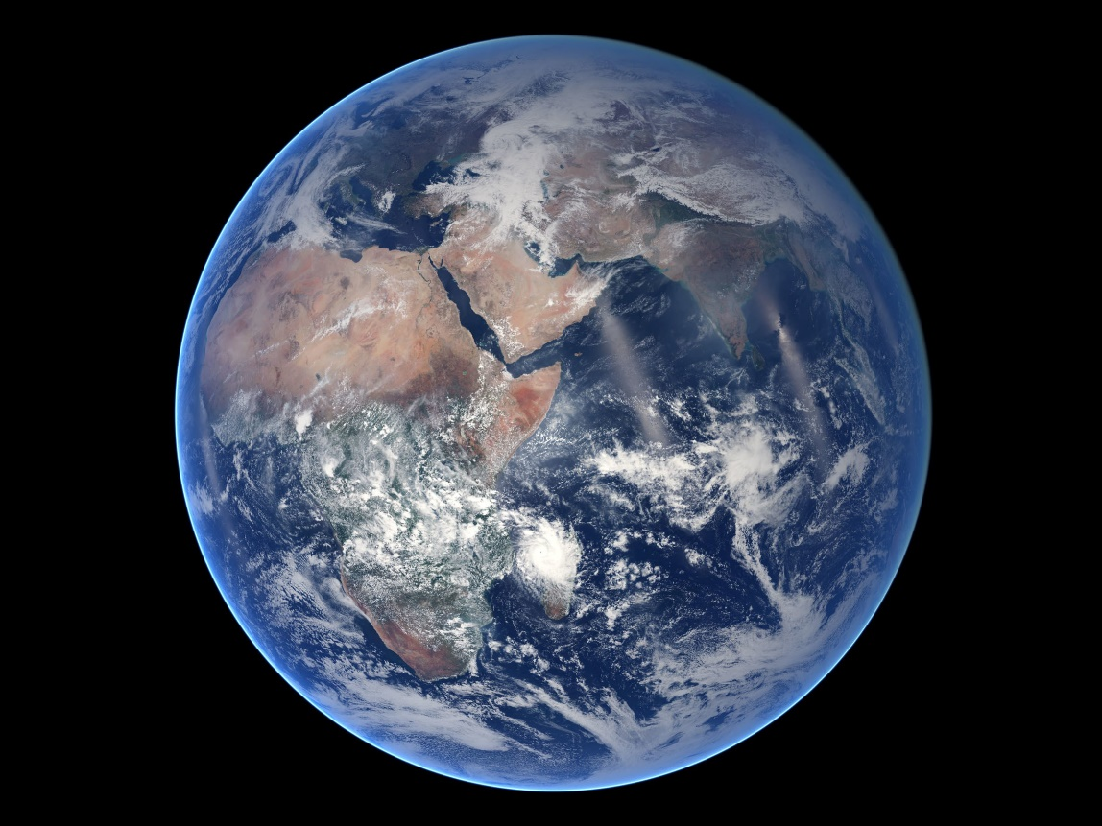
Our planet is deeply rhythmic
it orbits around sun
rotates around its axis
has an orbiting moon
-> light and darkness are complementary

Slide 3
Mentimeter:
1. What do you think light brings to nature?
2. What do you think darkness brings to nature?
(-> "rhythm is it")

Slide 4
Some effects of light & darkness on nature and people
+ + -> alternation is needed
Biological process | Light | Darkness | ALAN
Energy | + | - | more
Vision
Visual feeding and moving | + | - | more
Hiding from predators | - | + | less
Orientation
Phototaxis: attracted to light or darknes | + | + | more
Star compass | - | + | less
Health
Biological rhythm | + | +
Sleep | -/+ | + | disrupted
Fighting disease (metabolic, cancer) | + | + | less

Slide 5
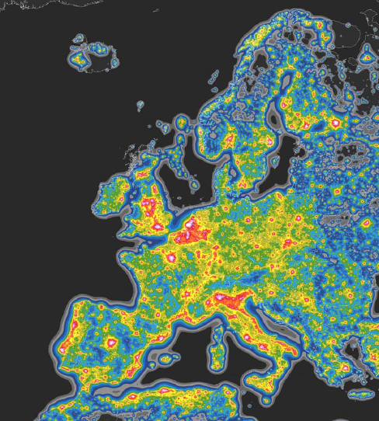
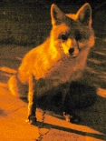
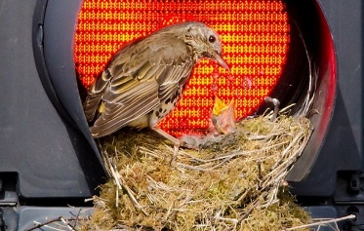
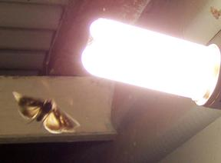
Now living things have a problem
Netherlands:
in Europe, highest Artificial Light at Night (ALAN)
Falchi et al. 2016

Slide 6
Mentimeter:
How do you perceive light at night (ALAN)?
1. What do you like about Artificial Light at Night?
2. What do you dislike about Artificial Light at Night?

Slide 7
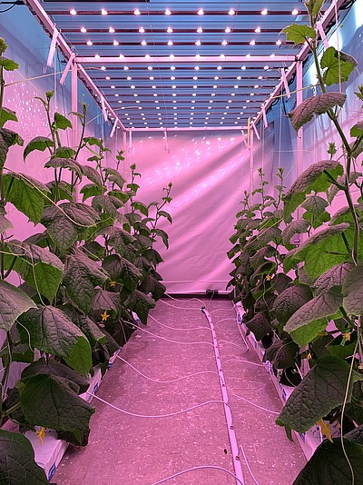
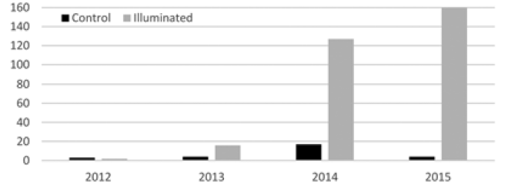
Energy to grow from ALAN
Plants grow with ALAN
… but so do slugs!
slugs per year
van Grunsven et al. 2017
-> typically mixed effects

Slide 8
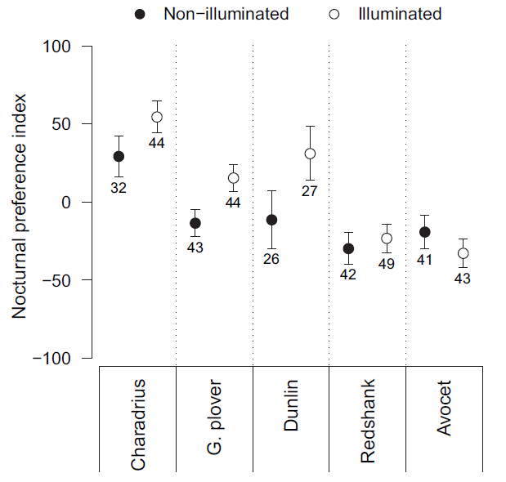
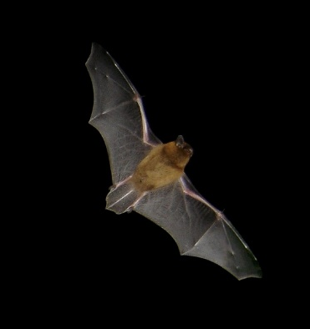
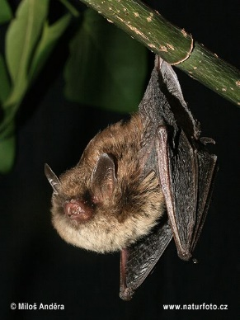
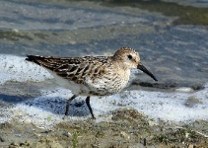
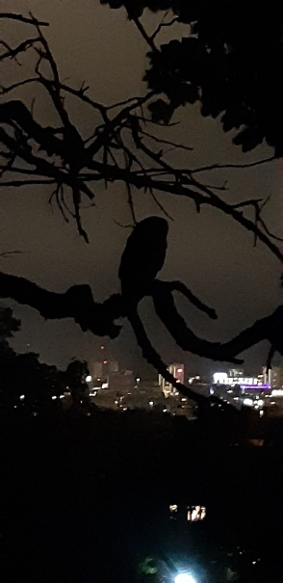
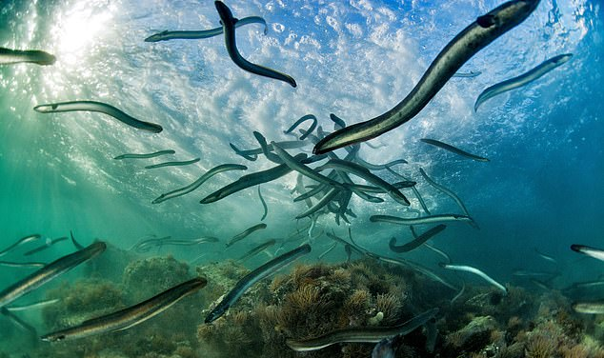
Vision: feeding and predation risk
Some species feed more under ALAN, including some waders
Others avoid ALAN and its risk of getting predated
+
Spoelstra et al. 2017
-
-
Santos et al. 2009
Vowles & Kemp 2021
Winners and losers! But overall biodiversity declines.

Slide 9
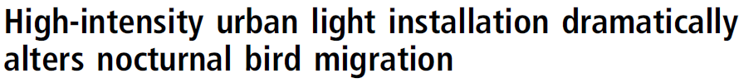
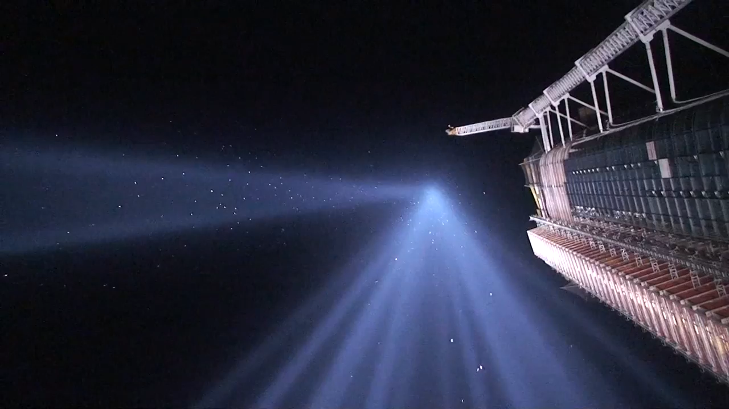
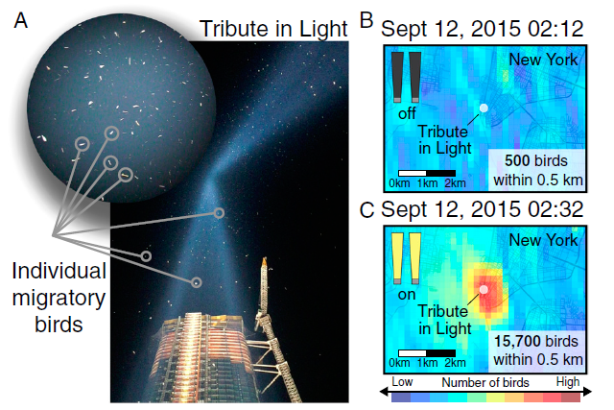
Orientation of migratory birds
Van Doren et al. 2017

Slide 10
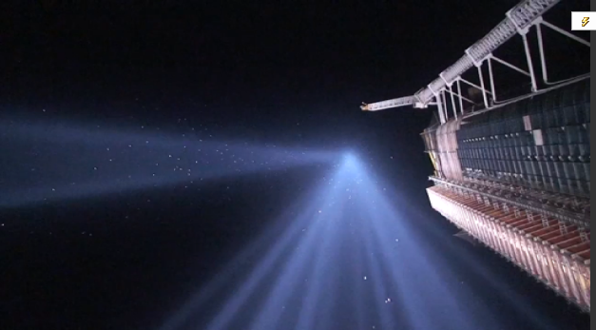
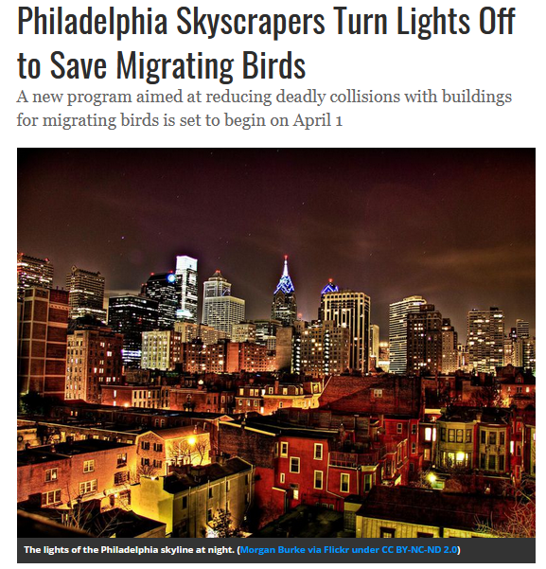
Orientation of migratory birds

Slide 11
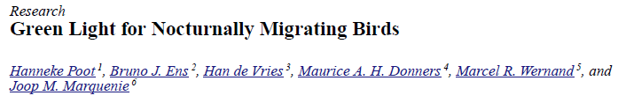
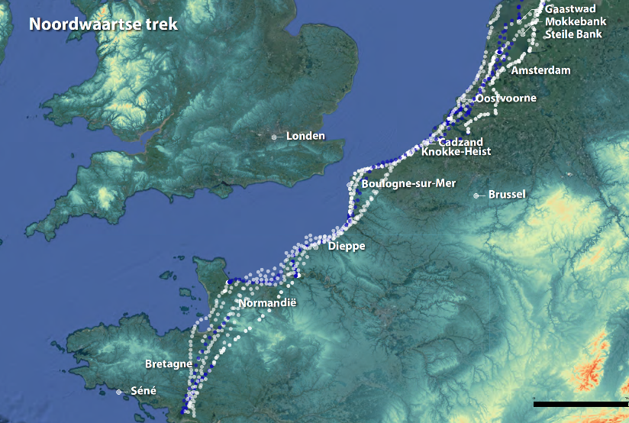
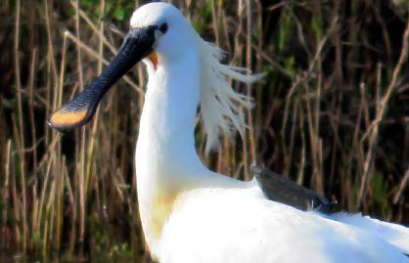
The Wadden, a migration flyway. Can migratory birds orient?
Production sites in the North Sea:
Experimental evidence caused change to lights
What about light along the coast?
Looking at spoonbill tracks with team Piersma:
starting with "Sinangote"

Slide 12
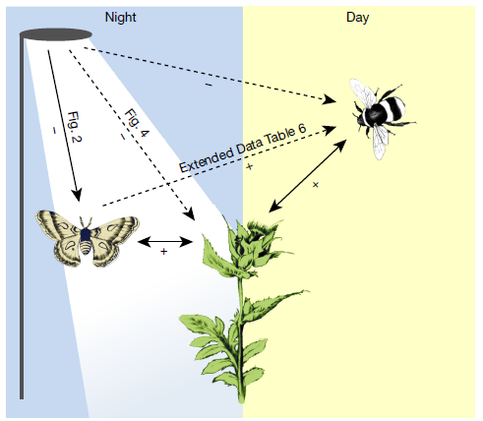
Effects of ALAN scale up to ecosystem-level
Major role for ALAN in "Insect Apocalypse" (i.e., massive decline of insects)
Knop et al. 2017
-> Conservation areas can fully function only if protected from ALAN. Unlike for global warming, this can be achieved locally.

Slide 13
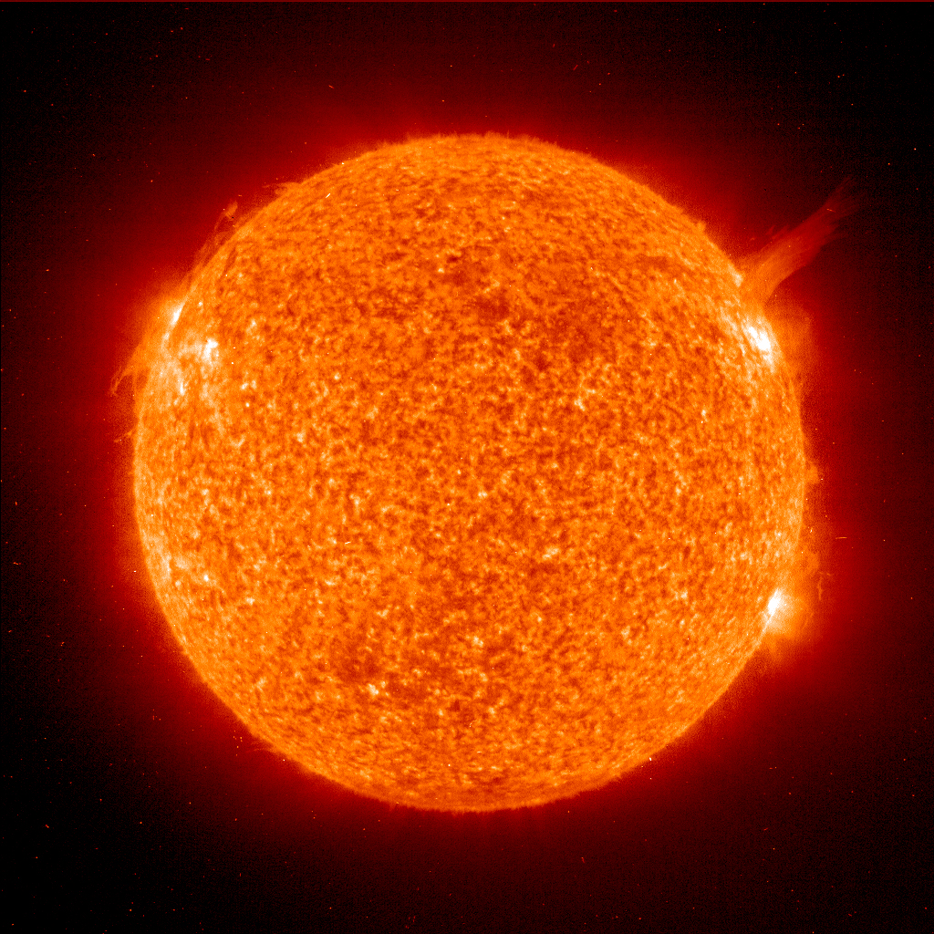
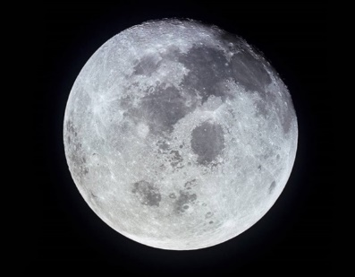
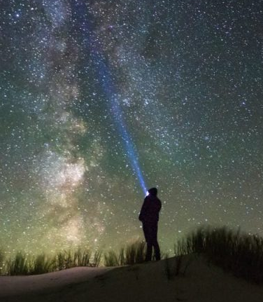
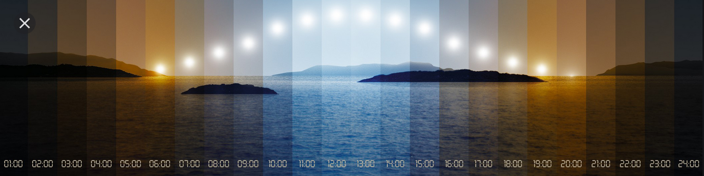
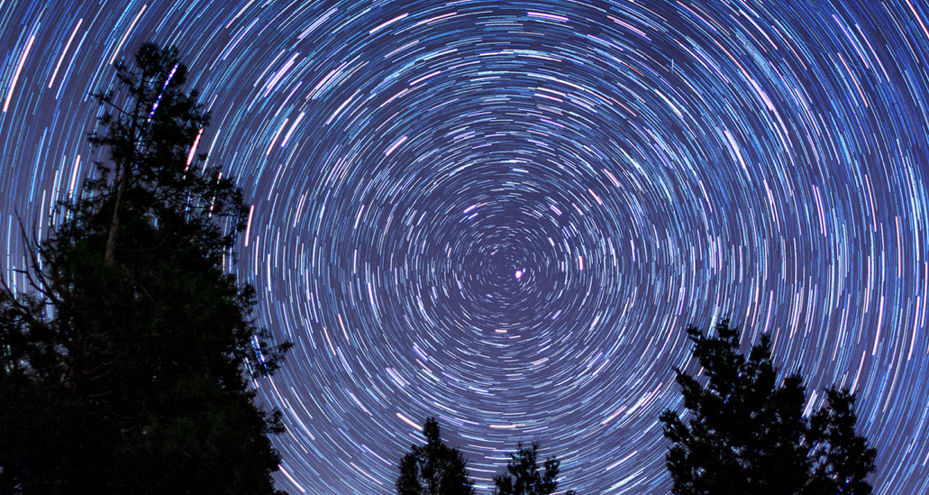
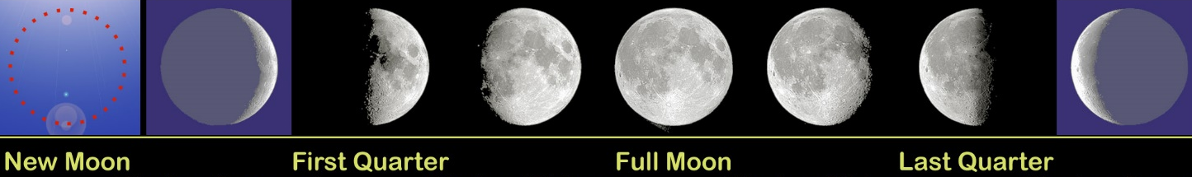
Rhythms of Earth's naturally changing light

Slide 14
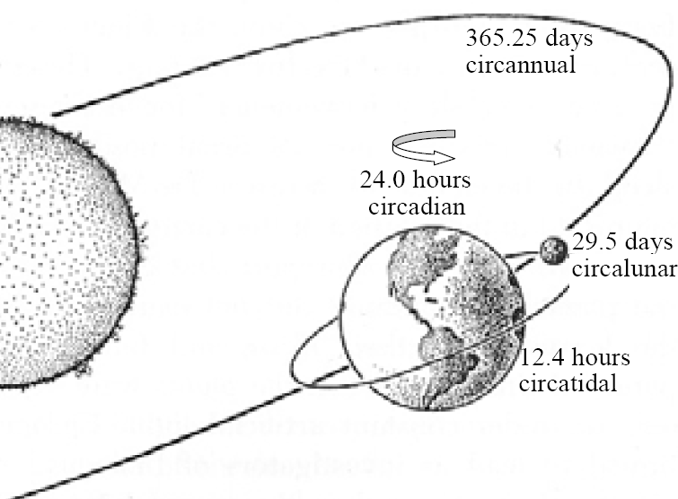
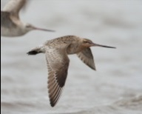
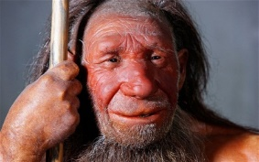
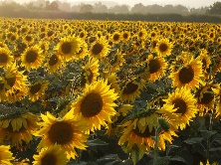
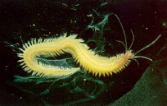
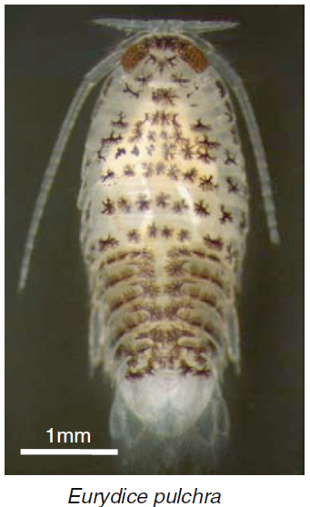
Planetary rhythms embodied: biological clocks
migration
year
circannual
sleep-wake
circadian
heliotropism
day
lunar
month
spawning
circalunar
tidal
cycle
swimming
circatidal
Key insight:
Living things have internal clocks tuned to light

Slide 15
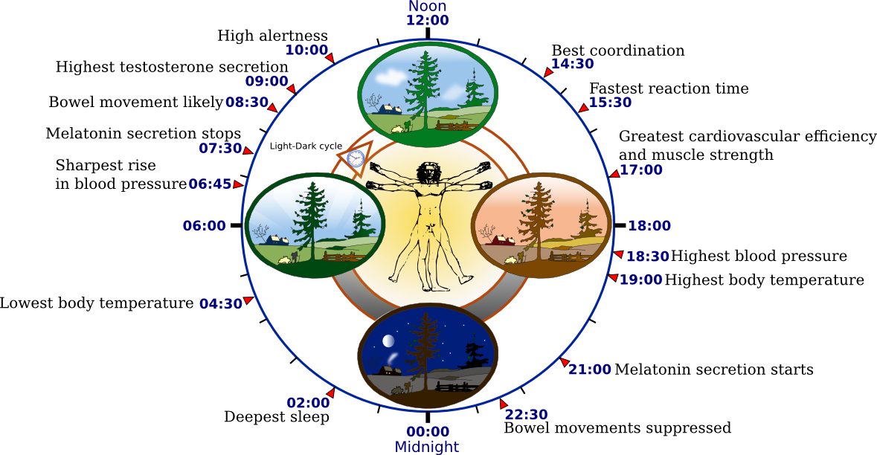
Daily rhythms in the human body (there are many more!)
Image: wikipedia

Slide 16

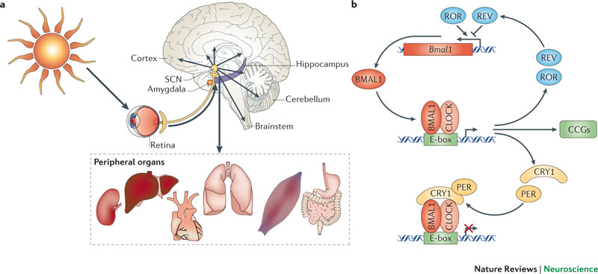
So many rhythms in the body!
Alternation of light and darkness keeps them synchronised
Light, the main synchroniser
Many rhythms in the body
Molecular feed-back loops
Kontradova & Kontradov 2012

Slide 17
Mentimeter:
Light at night – blessing or curse?
On a scale from 10 (positive) to 1 (negative), how do you perceive the overall pay-off of ALAN?

Slide 18
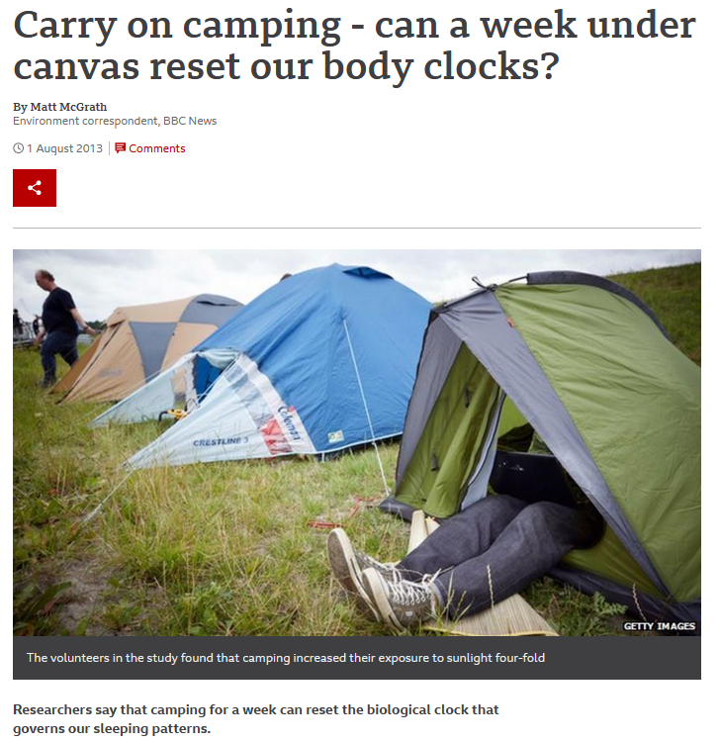
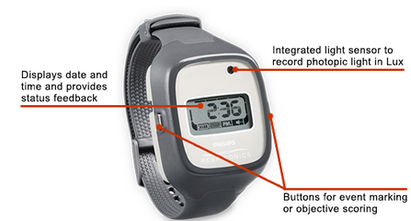
Ways forward
In politics and public, we need to protect darkness
Personally, we can seek temporary escape from ALAN. But this requires dark places.
?
Yes! And it's measurable!
-> Wadden Darkness – a true asset
Wright et al. 2013, and blog BBC

Slide 19
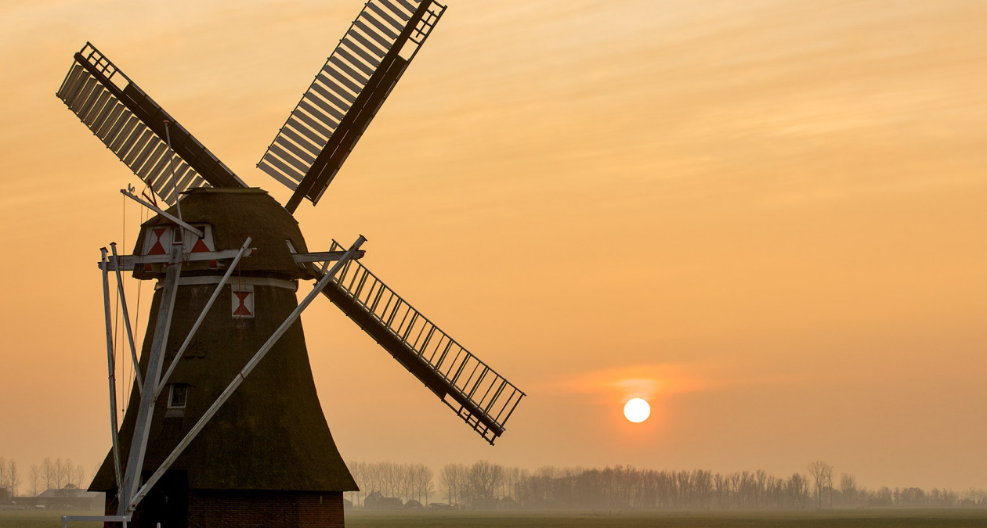
THANKS!

